Slide 1

Musings on
Storm Based Warnings
Daryl Herzmann
Iowa State University

Slide 2
Indisputable Fact of Life #1
The weather bureau is currently unable to issue storm based warnings.

Slide 3
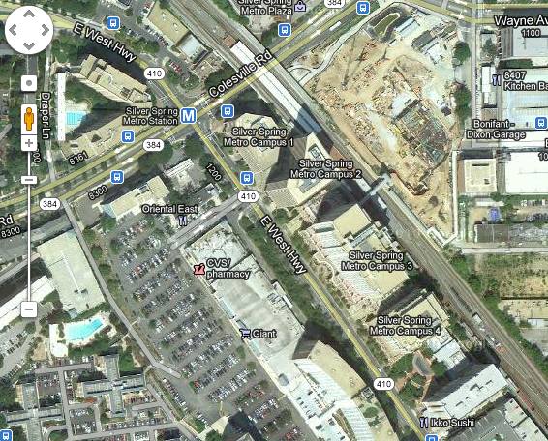
The reason why

Slide 4
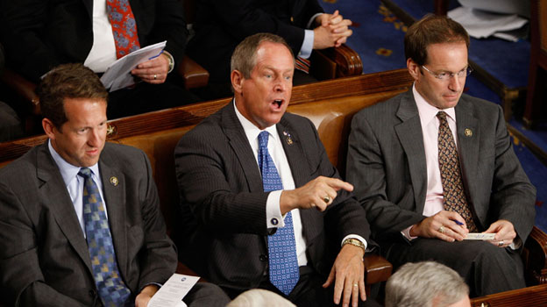
Oh, you don’t agree?

Slide 5

So I challenge you:
Go to your fancy AWIPS station and draw me a storm based warning for a tornado spotted in:
  South Yankton
  Hamburg Bend Conservation Reserve
  St Petersburg, FL

Slide 6
Oh, you still don’t agree?
(Or, everyone does agree because this is such a smart office or is adverse to confrontation)

Slide 7
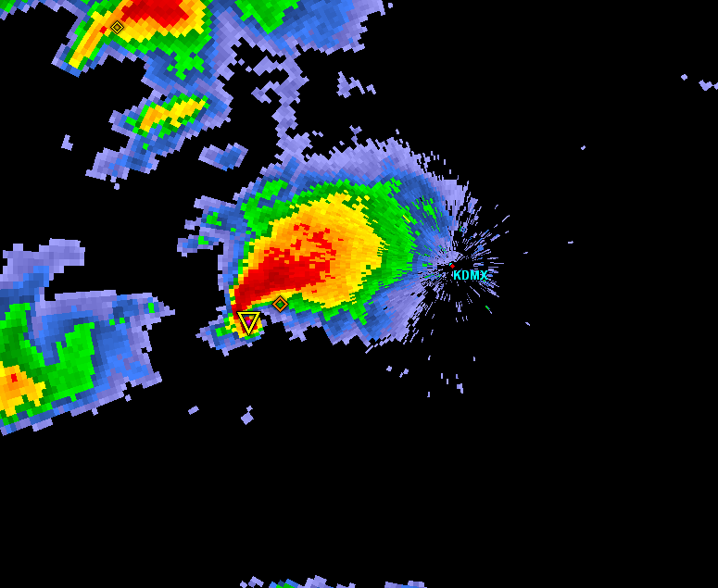
Warning Process Evaluation
Garden Variety Tornado
We had better warn.

Slide 8
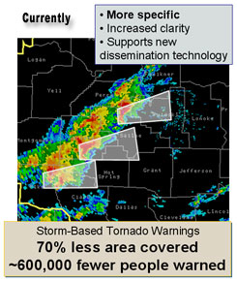
Warning Process Evaluation
Yippee, we can use our fine training and draw a polygon!

Slide 9
Warning Process Evaluation
I draw my fancy pants polygon out for 30 minutes.
I’m done, right?

Slide 10
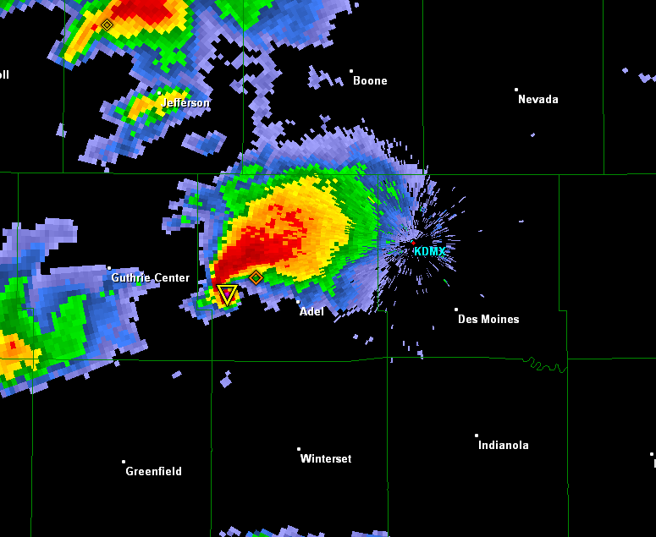
daryl’s here
Warning Process Evaluation
Gasp, I’m warning for 5 counties! Sirens will go off
In all 5!

Slide 11
daryl’s stays asleep
Warning Process Evaluation
WarnGen clipping to the rescue!

Slide 12
Warning Process Evaluation
Whoa, what happened?

Slide 13
Darn it daryl,
I came here for stats (or free food), not altruistic hyperbole.

Slide 14
NWS County SVR/TOR Warnings
Storm Based Warnings
NEXRAD

Slide 15
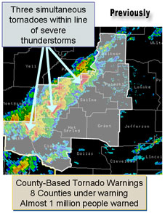
1 Oct 2007, warnings changed
http://www.weather.gov/sbwarnings/
“Storm-Based Warnings show the specific meteorological or hydrological threat area and are not restricted to geopolitical boundaries.”

Slide 16
But what actually changed?
NWS: Ignore the red, use the yellow
291
WUUS53 KDMX 182302
SVRDMX
IAC007-117-125-135-181-182345-
/O.NEW.KDMX.SV.W.0171.100618T2302Z-100618T2345Z/
BULLETIN - IMMEDIATE BROADCAST REQUESTED
SEVERE THUNDERSTORM WARNING
NATIONAL WEATHER SERVICE DES MOINES IA
602 PM CDT FRI JUN 18 2010
THE NATIONAL WEATHER SERVICE IN DES MOINES HAS ISSUED A
* SEVERE THUNDERSTORM WARNING FOR...
NORTHWESTERN APPANOOSE COUNTY IN SOUTH CENTRAL IOWA...
NORTHEASTERN LUCAS COUNTY IN SOUTH CENTRAL IOWA...
SOUTHWESTERN MARION COUNTY IN SOUTH CENTRAL IOWA...
MONROE COUNTY IN SOUTH CENTRAL IOWA...
SOUTHEASTERN WARREN COUNTY IN SOUTH CENTRAL IOWA...
* UNTIL 645 PM CDT
* AT 600 PM CDT...NATIONAL WEATHER SERVICE DOPPLER RADAR INDICATED A
SEVERE THUNDERSTORM CAPABLE OF PRODUCING GOLF BALL SIZE HAIL...AND
DAMAGING WINDS IN EXCESS OF 60 MPH. THIS STORM WAS LOCATED 10
MILES NORTHEAST OF CHARITON...OR 36 MILES SOUTHEAST OF DES
MOINES...AND MOVING SOUTHEAST AT 30 MPH.
* LOCATIONS IMPACTED INCLUDE...
ALBIA...RUSSELL...MELROSE AND LOVILIA.
PRECAUTIONARY/PREPAREDNESS ACTIONS...
MOVE TO AN INTERIOR ROOM AND STAY AWAY FROM WINDOWS. IF YOU ARE IN A
MOBILE HOME...GET OUT NOW...AND SEEK SHELTER IN A REINFORCED
BUILDING.
A TORNADO WATCH REMAINS IN EFFECT FOR THE WARNED AREA. SEVERE
THUNDERSTORMS CAN PRODUCE TORNADOES WITH LITTLE OR NO WARNING. IF A
TORNADO IS SPOTTED...IMMEDIATELY MOVE TO THE BASEMENT OR SMALL
INTERIOR ROOM OF A REINFORCED BUILDING.
TORRENTIAL RAINFALL IS ALSO OCCURRING WITH THIS STORM...AND MAY LEAD
TO FLASH FLOODING. DO NOT DRIVE YOUR VEHICLE THROUGH FLOODED
ROADWAYS. TURN AROND DON'T DROWN.
&&
LAT...LON 4089 9310 4090 9310 4090 9313 4112 9357
4116 9357 4116 9358 4135 9335 4105 9272
4084 9301
TIME...MOT...LOC 2302Z 300DEG 28KT 4114 9321
WIND...HAIL 60MPH 1.75IN
$$
SMALL

Slide 17
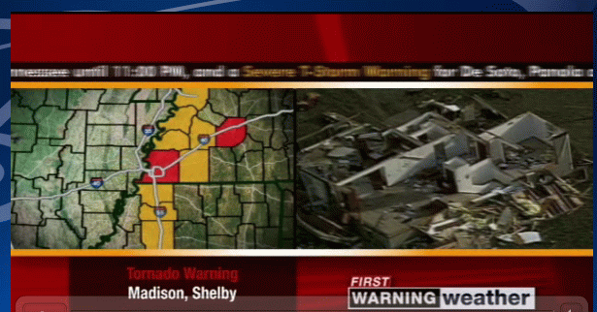
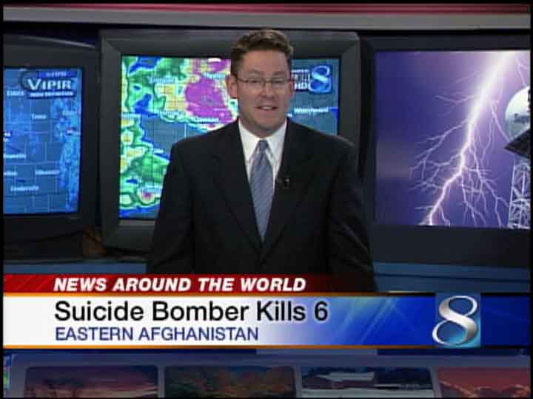

The private sector jumped to action
Comic Relief
Lifted from Barons and WXC website. Those
are county warnings!

Slide 18


Thankfully, we have social media
Great job daryl on iembot !
….. FAIL .…

Slide 19


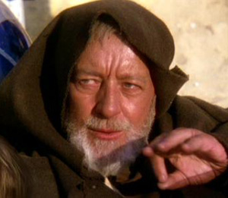
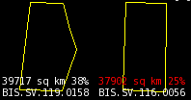
These aren’t the polygons you’re looking for
(Maryland == 26,000 sq km)

Slide 20
Oh daryl, you and your
1% type academic friends always focused on the outliers….
So another altruism:
If less than 50% of warnings are “storm based”, can the program still keep its name?

Slide 21
Quiz Question #1
How do you cancel a portion of the warning?
Answer: Cancel one of the counties in the warning!
IAC181-182341-
/O.CAN.KDMX.SV.W.0171.000000T0000Z-100618T2345Z/
...THE SEVERE THUNDERSTORM WARNING FOR SOUTHEASTERN WARREN COUNTY IS
CANCELLED...
IAC007-117-125-135-182345-
/O.CON.KDMX.SV.W.0171.000000T0000Z-100618T2345Z/
...A SEVERE THUNDERSTORM WARNING REMAINS IN EFFECT FOR SOUTHWESTERN
MARION...MONROE...EASTERN LUCAS AND NORTHWESTERN APPANOOSE COUNTIES
UNTIL 645 PM CDT...

Slide 22
Quiz Question #2
What’s wrong with this picture?

Slide 23
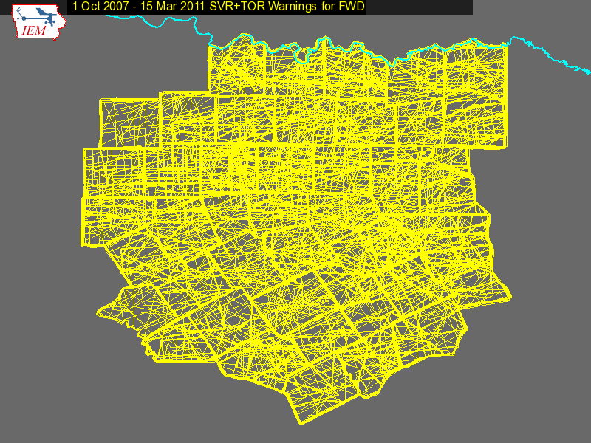

Slide 24
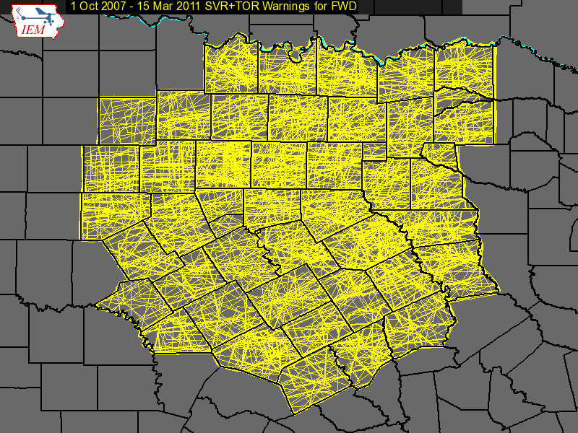

Slide 25

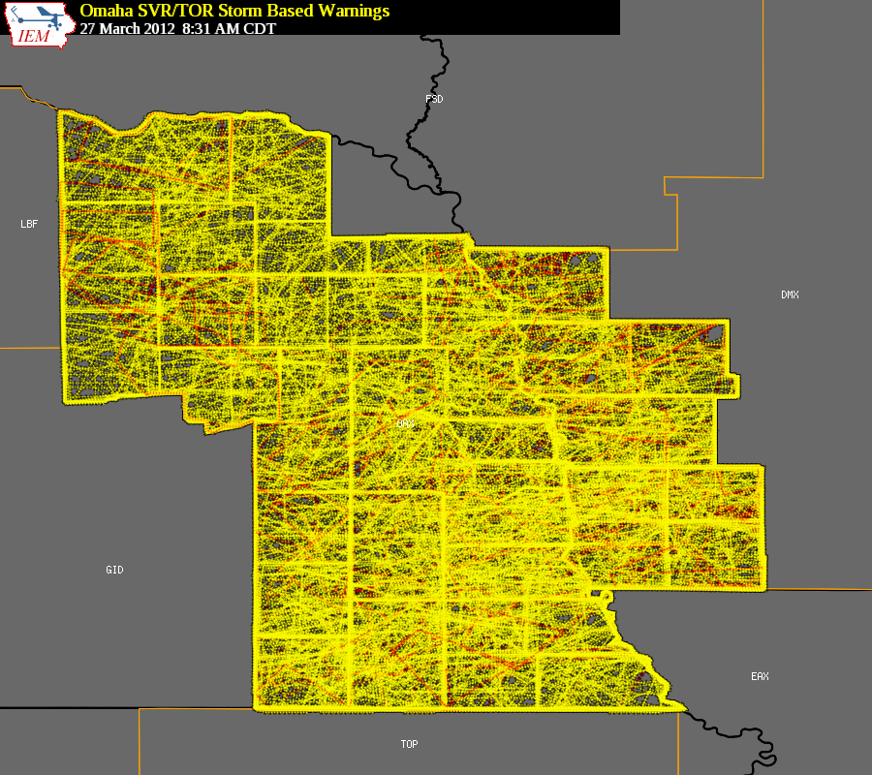

Bah, that is Texas, we are Omaha, fricken Nebraska

Slide 26
1 Oct 2007 – 23 Mar 2012:
Number of Polygon Vertices (SVR+TOR)
~50%
~8%

Slide 27
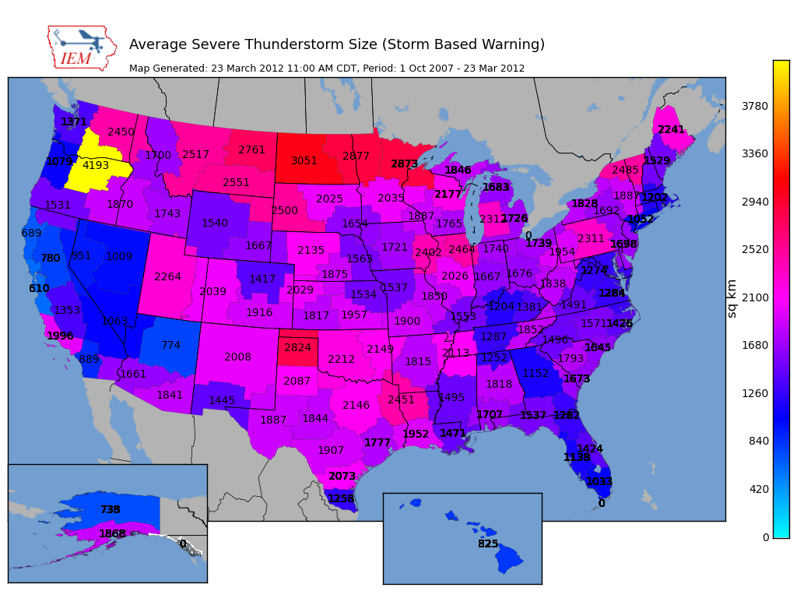

Slide 28
Average SBW Size Versus County Size per WFO
(SVR+TOR shown, Alaska not included)

Slide 29
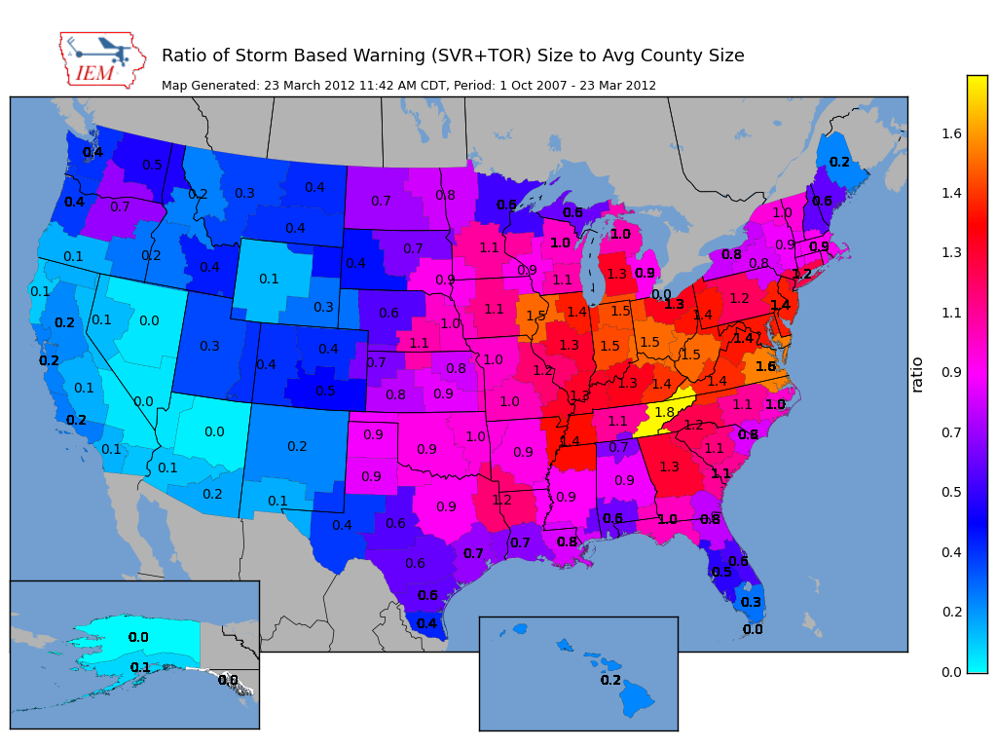

Slide 30
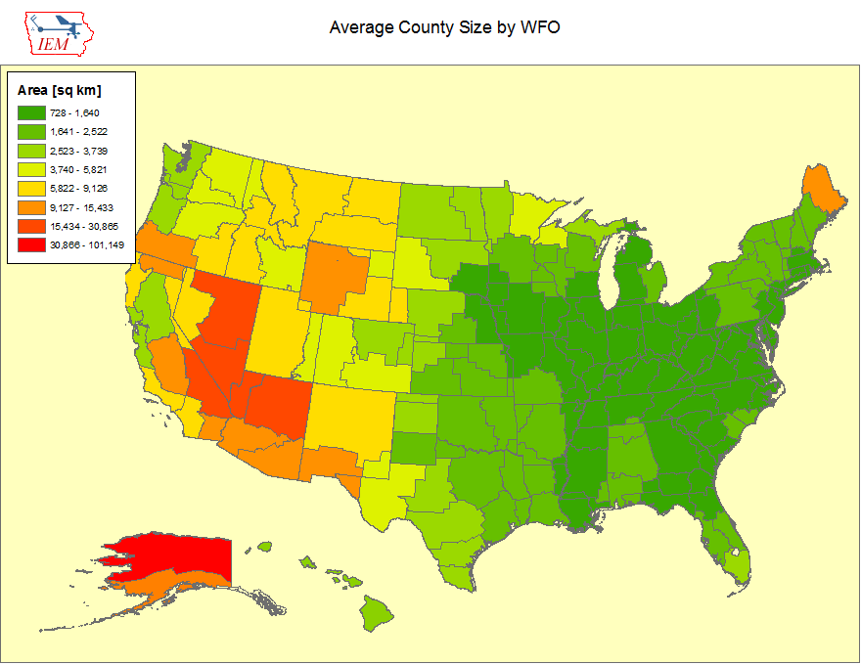

Slide 31
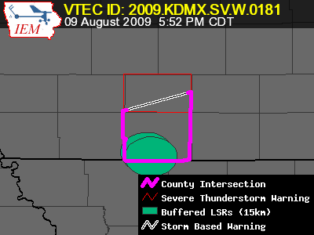
Lets get quantitative
Perimeter Influence
  How much of the polygon perimeter coincides with a political boundary
Areal Verification
  If the LSRs are buffered, what areal percentage verified
Size Reduction
  How much smaller was the warning than the counties it was issued against.

Slide 32
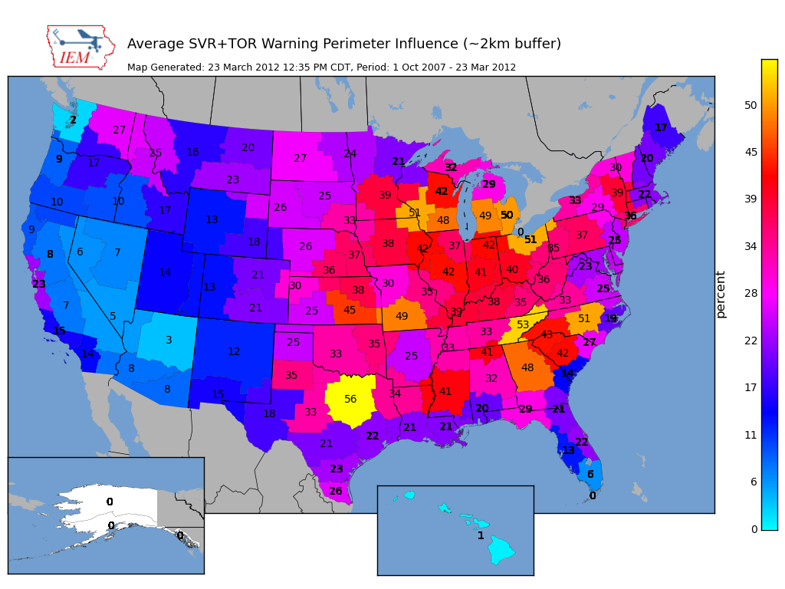

Slide 33
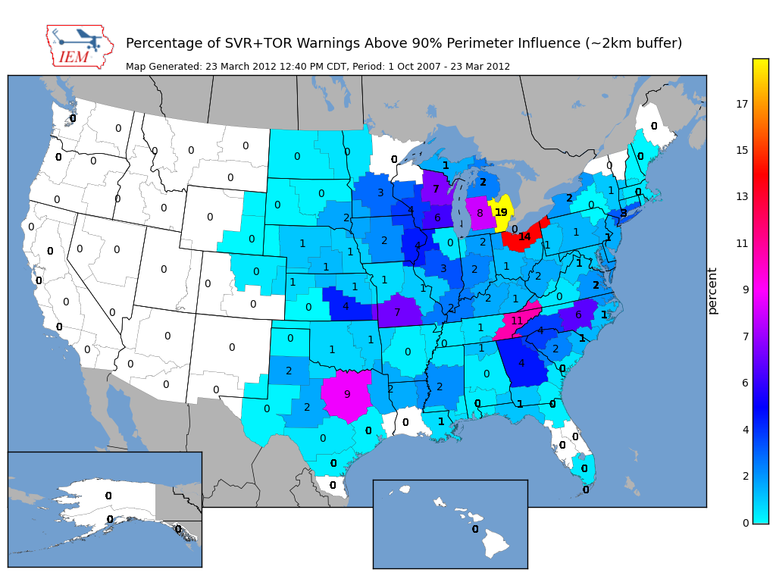
~ 2 % of all warnings

Slide 34
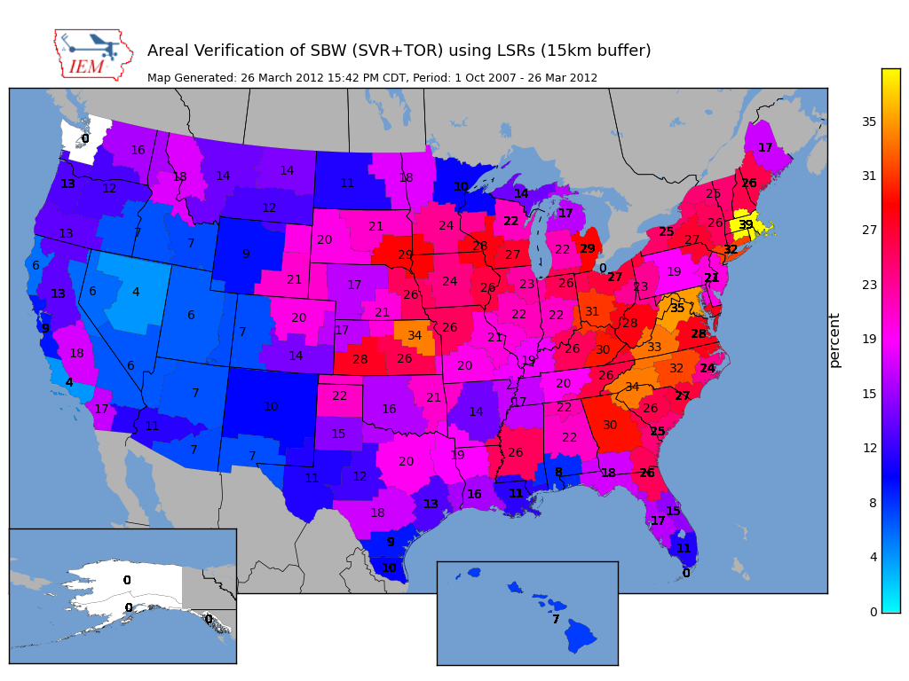
Nationwide is around 25%

Slide 35
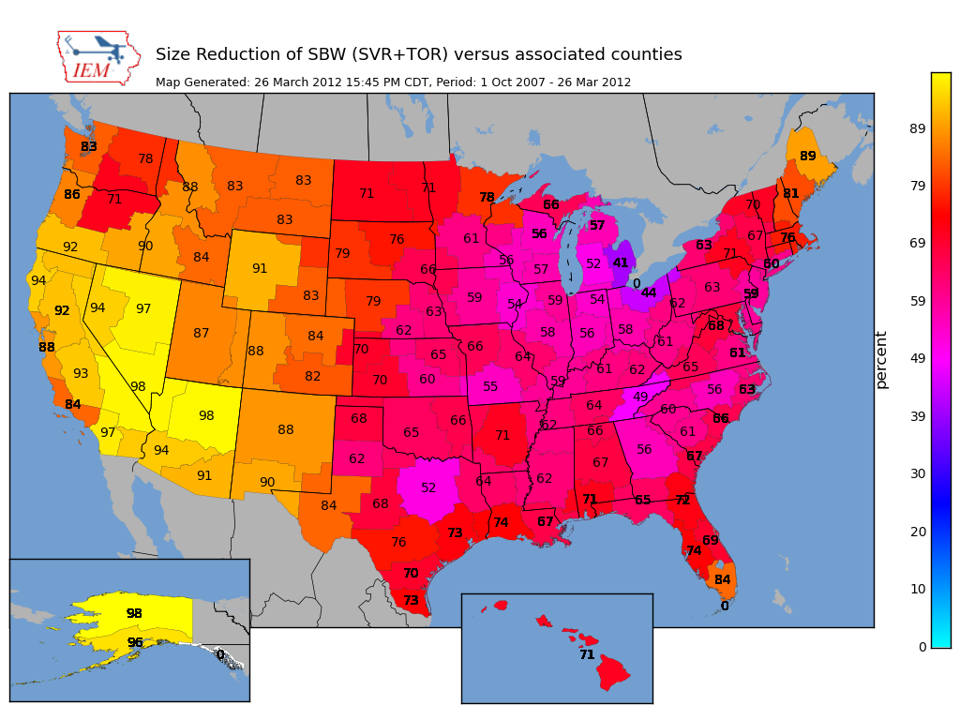
Nationwide Average: 65%

Slide 36
Oh daryl, what about this?
Perimeter ratio is small
So lets compute another metric measuring distance of vertex to county border
County
Warning

Slide 37
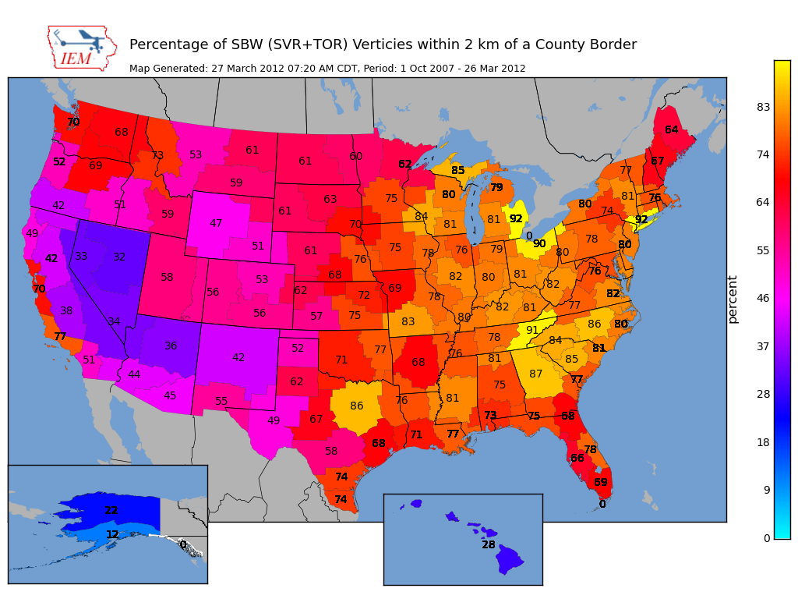
Overall Average: 75%
Overall: 75%

Slide 38
Are warnings centered on the storm?
Compute centroid of TIME…MOT…LOC
Compare against Polygon Centroid

Slide 39
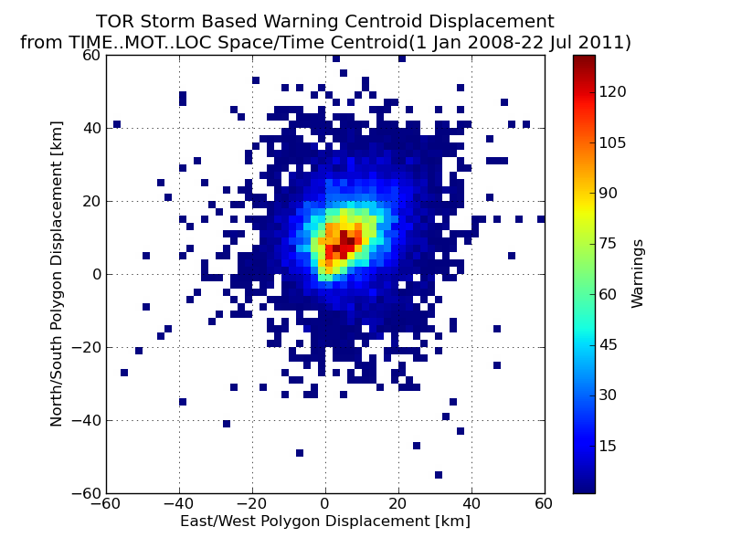

Slide 40
Does the warning track the storm in space?
Compute moving threat TIME…MOT…LOC
perpendicular to motion vector, compute
report displacement

Slide 41
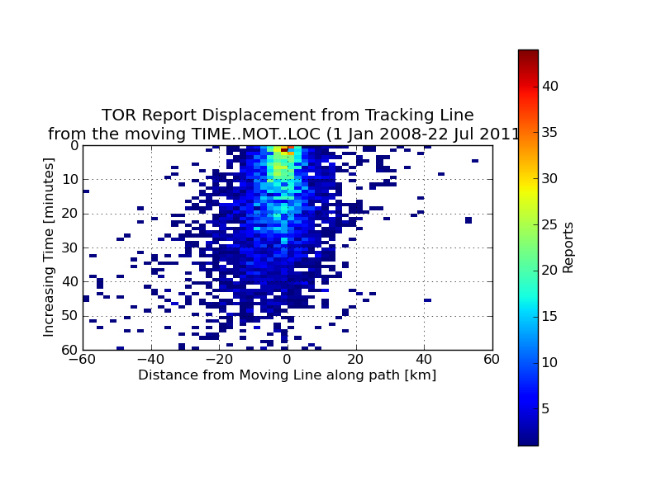
Most reports are 0-10 km south of the
TIME…MOT…LOC

Slide 42
More tracking fun
Does storm tracking accuracy
decrease with time?

Slide 43
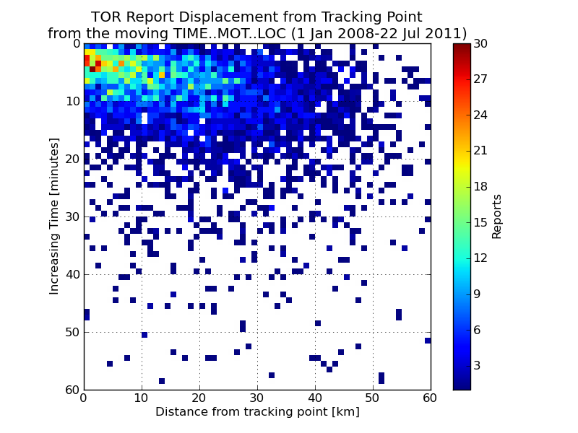

Slide 44
Academic Thought Experiment
Take TIME..MOT.LOC and draw my own warning:
30 min duration
~10 km left
~10 and increase to 30 km to the right
Which will #win ?

Slide 45
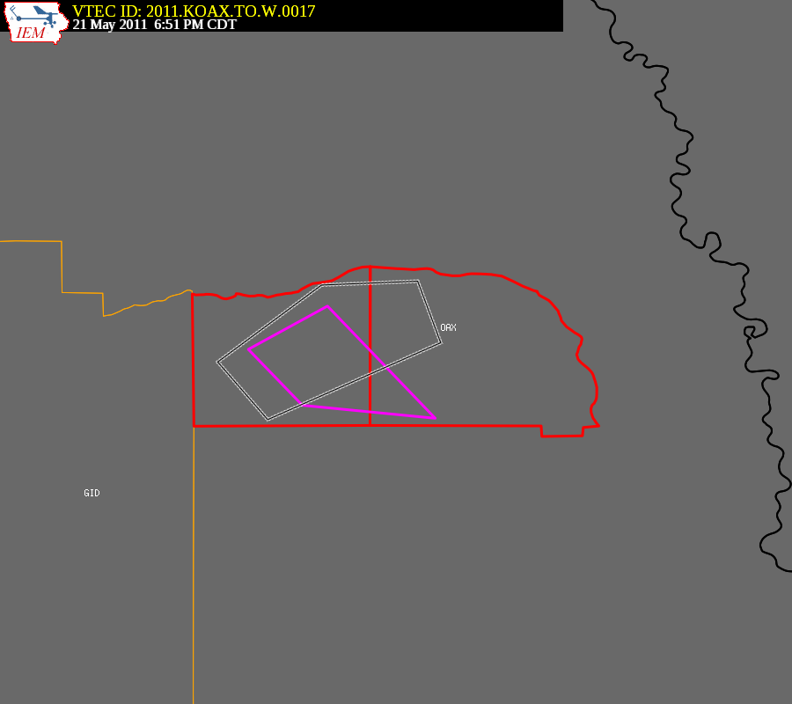
Purple box is the warning from
the automated algorithm

Slide 46
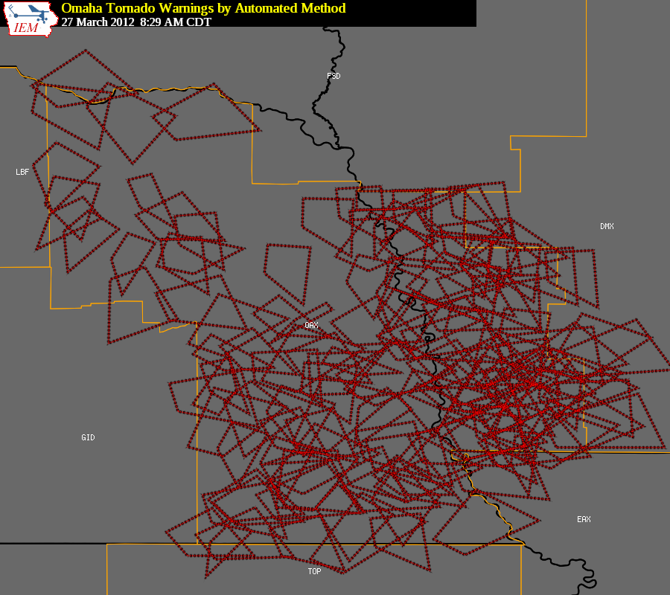
Purple box is the warning from
the automated algorithm

Slide 47
Omaha’s TORs 2008-2011
 | WEATHER BUREAU | ACADEMIA
Average Size (sq km) | 964 | 910
Areal Verification | 13.7% | 12.1%
Vertex County Intersection | 71% | 22%
Size Reduction | 72.3% | Didn’t Compute
Perimeter Ratio | 33% | 8%
Probability of Detection | 0.79 | 0.68
False Alarm Rate | 0.72 | 0.77
Critical Success Index | 0.26 | 0.20
Did the weather bureau #win?

Slide 48
What is broken?
The warnings are constrained by political boundaries!
  NWS Office can’t issue outside CWA
  Warning product (VTEC) is still bound to UGC codes
  Can’t issue SVR/TOR over Marine Zones, why ?!?!
No penalty for warning size in verification
Warning issuance software
Warning dissemination software (bad daryl)
Warning display software (bad daryl)
Some local NWS Office policies conflict with NWS directives, where’s the sheriff?
No topology checks, invalid geometries are OK

Slide 49
Summary
~ 25% of TOR/SVR Warnings are 4 sided
Only ~ 2 % of all SVR/TOR warnings are pure county retracements
~ 75% of polygon vertices are guided by county borders
SBWs have cut the size of warnings by over 60%, but the number of warnings has increased by 60%.
The Cubs will not win the World Series this year

Slide 50

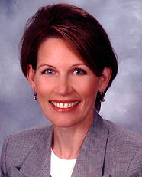
Is this the solution?

Slide 51
Equally, unrealistic solutions
Warnings should be data, not products
  Computers are the most important readers…
  UGC codes should not be included
Warnings should come from NWS, not WFOs
  NWS should be working as a team, instead of theifdoms
Polygons should be limited to 4 to 6 sides.
The Cubs develop talent from their farm system and not overpay for free agents that struggle with the rigors of playing left field.

Slide 52
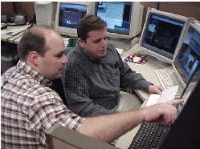



NWS Issues Products
Forecaster tries to figure out what the public wants
Disseminates
Public doesn’t call
Congress.
Computer angry!
NWS Issues Data
Computers deal with various users
Disseminates
Computer happy!
Meathead happy!

Slide 53

Time for Questions?
mesonet.agron.iastate.edu
Daryl Herzmann
515.294.5978
akrherz@iastate.edu

