Slide 1
IEM Dog and Pony Show
Daryl Herzmann
@akrherz
Iowa State University
Notes:
Here we go!

Slide 2
Who am I and why am I here?
2001 Meteor BS degree
Work for Iowa State University
Contractor with NWS
Co-Creator of NWSChat
I like free food (note: remove this before talk if no free food is present)
Photo: AP Images
Notes:
Admiral Stockdale wondered why he was at the vice president debate, so some wonder why I am here giving this talk. If the women do not find you handsome, they should at least find you handy.

Slide 3
See something you don’t like? Yell at me!
Photo: AP Images
Notes:
This guy interrupted the president, so surely you can interrupt me.

Slide 4
Diplomatic Immunity
June 2012 NOAA Team Member of the Month
2007 NOAA Environmental Hero
Notes:
I win awards, so I can complain about the people that give me awards.

Slide 5
What’s a Dog and Pony Show?
Wikipedia - "Dog and pony show" is a colloquial term which has come to mean a highly promoted, often over-staged performance, presentation, or event designed to sway or convince opinion for political, or less often, commercial ends.
Photo: Blogspot.com
Notes:
Lots of show upcoming, buckle up.

Slide 6
What shall we discuss?
Jacob B wanted to know about percentages of winter watches ending up in warnings.
My standard ranting about storm based warnings
IEM archives and web tools that may help you out
IEM Cow
IEM Raccoon
Notes:
The next fifty minutes of your life will consist of this tedium

Slide 7
Purpose of my maps is not to show good/bad offices, but show local gradients
Notes:
The question in this plot is NOT why MPX is 10 and everyone else is 5, but why is MPX 10 and their neighbors all five or three. The meteorology should not change that much between WFOs.

Slide 8
Watches & Warnings
Chapter 1

Slide 9
1 Oct 2005 – 28 Feb 2014 NWS Conversion of Watches into Warnings
(double accounting means totals can be over 100%)
3,669 UGC
Blizzard Watches
Blizzard Warning
75.6%
Winter Storm Warning
11.1%
Wind Chill Warning
11.6%
Wind Chill Advisory
7.5%
No WWA
5.8%
73,428 UGC
Winter Storm Watches
Winter Storm Warning
60.6%
Winter Weather Advsiory
34.4%
Blizzard Warning
6.1% (4,459!!)
Snow Advisory
5.3%
No WWA
4.6%

Slide 10
1 Oct 2005 – 28 Feb 2014 NWS Watches before a Warning
(double accounting means totals can be over 100%)
8,702 UGC
Blizzard Warnings
Winter Storm Watch
51.2%
Blizzard Watch
31.3%
No Watch
26.0%
High Wind Watch
2.7%
Wind Chill Watch
0.7%
64,980 UGC
Winter Storm
Warnings
Winter Storm Watch
70.6%
Areal Flood Watch
1.2%
High Wind Watch
0.8%
Blizzard Watch
0.7%
No Watch
28.1%

Slide 11
10% of Blizzard Warnings are dumped by half way through warning
Less than half make it to expiration
5% last double initial issuance

Slide 15
1 Oct 2005 – 28 Feb 2014 NWS Watches before a Warning
(double accounting means totals can be over 100%)
54,020 UGC
Tornado Warnings
Tornado Watch
69.9%
SVR Watch
14.9%
No Watch
15.7%
409,555 UGC
SVR Warnings
SVR Watch
36.4%
Tornado Watch
22.5%
No Watch
41.4%

Slide 18
My standard “Storm based” Warnings ranting
Chapter 2

Slide 19
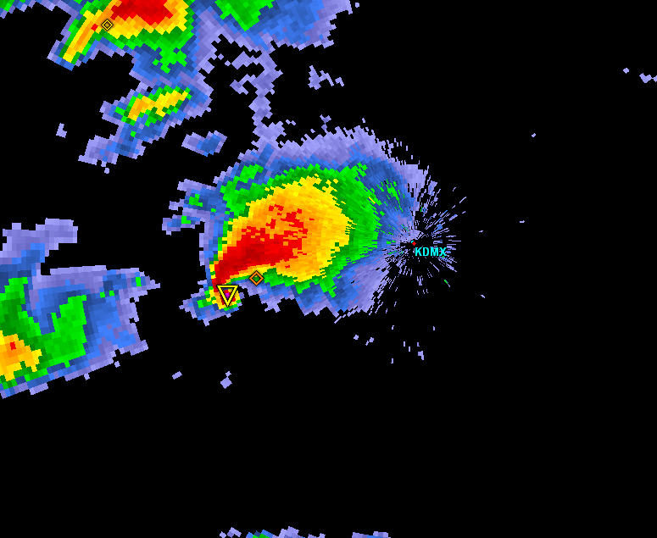
Warning Process Evaluation
Garden Variety Tornado
We had better warn.

Slide 20
Warning Process Evaluation
Yippee, we can use our fine training and draw a polygon!

Slide 21
Warning Process Evaluation
I draw my fancy pants polygon out for 30 minutes.
I’m done, right?

Slide 22
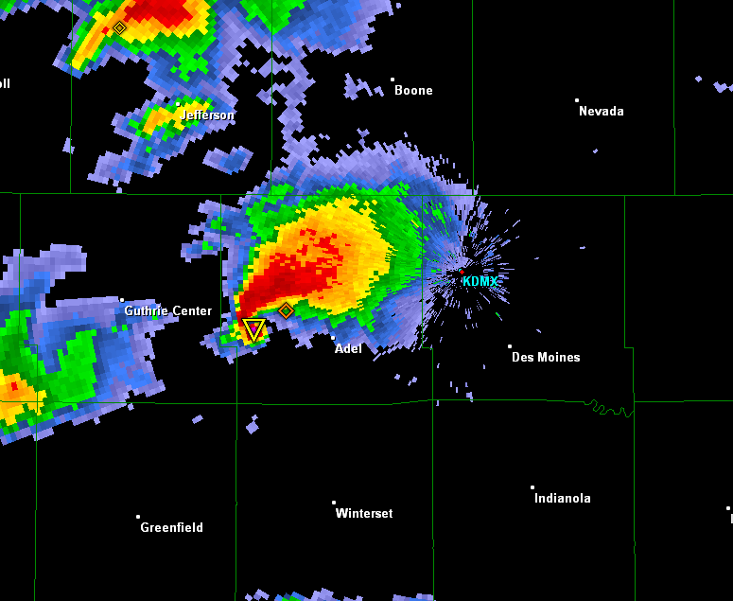
daryl’s here
Warning Process Evaluation
Gasp, I’m warning for 5 counties! Sirens will go off
In all 5!

Slide 23
daryl’s stays asleep
Warning Process Evaluation
WarnGen clipping to the rescue!

Slide 24
Warning Process Evaluation
Whoa, what happened?

Slide 25
Darn it daryl, I came here for stats (or free food), not altruistic hyperbole.

Slide 26
NWS County SVR/TOR Warnings
Storm Based Warnings
NEXRAD

Slide 27
NWS Storm Based SVR/TOR Warnings

Slide 28
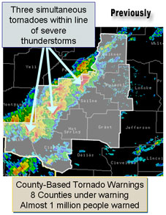
1 Oct 2007, warnings changed
http://www.weather.gov/sbwarnings/
“Storm-Based Warnings show the specific meteorological or hydrological threat area and are not restricted to geopolitical boundaries.”

Slide 29
But what actually changed? NWS: Ignore the red, use the yellow
291
WUUS53 KDMX 182302
SVRDMX
IAC007-117-125-135-181-182345-
/O.NEW.KDMX.SV.W.0171.100618T2302Z-100618T2345Z/
BULLETIN - IMMEDIATE BROADCAST REQUESTED
SEVERE THUNDERSTORM WARNING
NATIONAL WEATHER SERVICE DES MOINES IA
602 PM CDT FRI JUN 18 2010
THE NATIONAL WEATHER SERVICE IN DES MOINES HAS ISSUED A
* SEVERE THUNDERSTORM WARNING FOR...
NORTHWESTERN APPANOOSE COUNTY IN SOUTH CENTRAL IOWA...
NORTHEASTERN LUCAS COUNTY IN SOUTH CENTRAL IOWA...
SOUTHWESTERN MARION COUNTY IN SOUTH CENTRAL IOWA...
MONROE COUNTY IN SOUTH CENTRAL IOWA...
SOUTHEASTERN WARREN COUNTY IN SOUTH CENTRAL IOWA...
* UNTIL 645 PM CDT
* AT 600 PM CDT...NATIONAL WEATHER SERVICE DOPPLER RADAR INDICATED A
SEVERE THUNDERSTORM CAPABLE OF PRODUCING GOLF BALL SIZE HAIL...AND
DAMAGING WINDS IN EXCESS OF 60 MPH. THIS STORM WAS LOCATED 10
MILES NORTHEAST OF CHARITON...OR 36 MILES SOUTHEAST OF DES
MOINES...AND MOVING SOUTHEAST AT 30 MPH.
* LOCATIONS IMPACTED INCLUDE...
ALBIA...RUSSELL...MELROSE AND LOVILIA.
PRECAUTIONARY/PREPAREDNESS ACTIONS...
MOVE TO AN INTERIOR ROOM AND STAY AWAY FROM WINDOWS. IF YOU ARE IN A
MOBILE HOME...GET OUT NOW...AND SEEK SHELTER IN A REINFORCED
BUILDING.
A TORNADO WATCH REMAINS IN EFFECT FOR THE WARNED AREA. SEVERE
THUNDERSTORMS CAN PRODUCE TORNADOES WITH LITTLE OR NO WARNING. IF A
TORNADO IS SPOTTED...IMMEDIATELY MOVE TO THE BASEMENT OR SMALL
INTERIOR ROOM OF A REINFORCED BUILDING.
TORRENTIAL RAINFALL IS ALSO OCCURRING WITH THIS STORM...AND MAY LEAD
TO FLASH FLOODING. DO NOT DRIVE YOUR VEHICLE THROUGH FLOODED
ROADWAYS. TURN AROND DON'T DROWN.
&&
LAT...LON 4089 9310 4090 9310 4090 9313 4112 9357
4116 9357 4116 9358 4135 9335 4105 9272
4084 9301
TIME...MOT...LOC 2302Z 300DEG 28KT 4114 9321
WIND...HAIL 60MPH 1.75IN
$$
SMALL

Slide 30
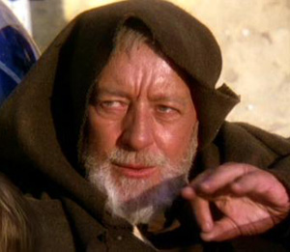
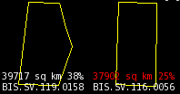
These aren’t the polygons you’re looking for
(Maryland == 26,000 sq km)

Slide 31
Oh daryl, you and your 1% type academic friends always focused on the outliers…. So another altruism: If less than 50% of warnings are “storm based”, can the program still keep its name?

Slide 32
Quiz Question #1 How do you cancel a portion of the warning?
Answer: Cancel one of the counties in the warning!
IAC181-182341-
/O.CAN.KDMX.SV.W.0171.000000T0000Z-100618T2345Z/
...THE SEVERE THUNDERSTORM WARNING FOR SOUTHEASTERN WARREN COUNTY IS
CANCELLED...
IAC007-117-125-135-182345-
/O.CON.KDMX.SV.W.0171.000000T0000Z-100618T2345Z/
...A SEVERE THUNDERSTORM WARNING REMAINS IN EFFECT FOR SOUTHWESTERN
MARION...MONROE...EASTERN LUCAS AND NORTHWESTERN APPANOOSE COUNTIES
UNTIL 645 PM CDT...

Slide 33
Quiz Question #2 What’s wrong with this picture?

Slide 34
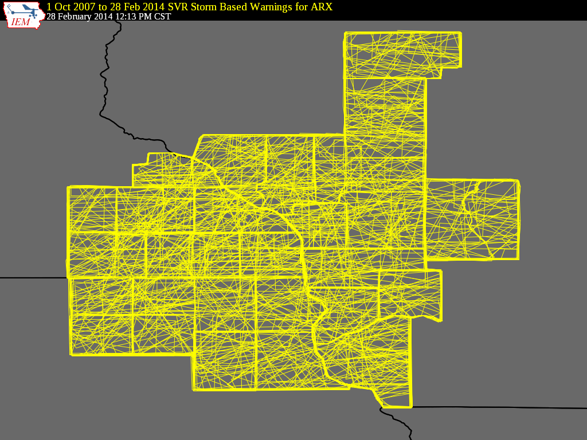

Slide 35
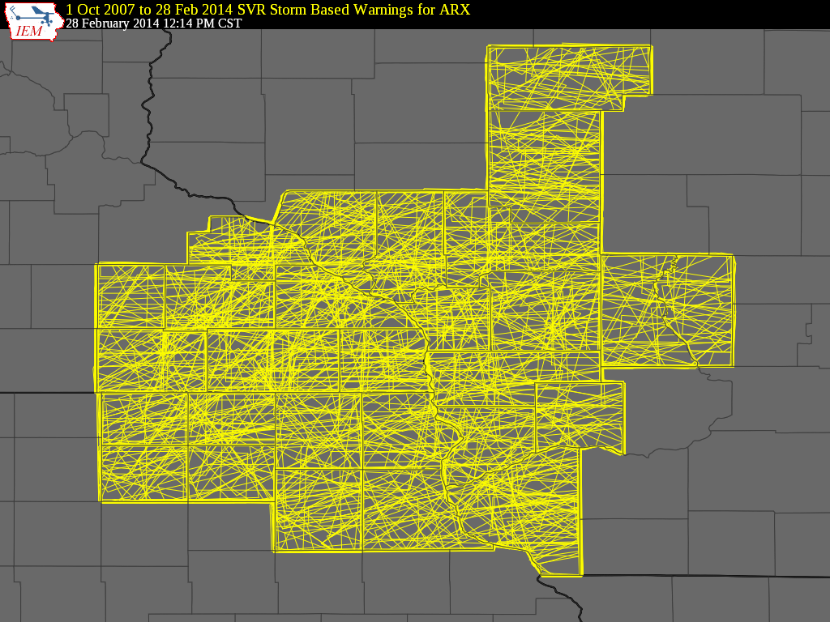

Slide 36
Bah, that is La Crosse, we are Chanhassen, fricken Minnesota

Slide 37
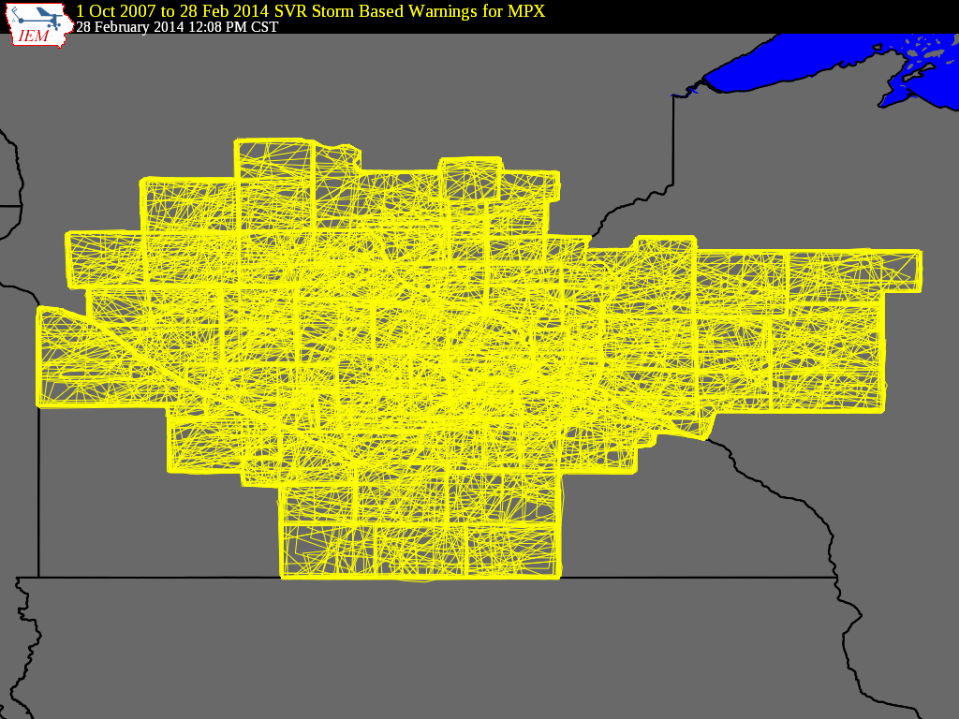

Slide 39
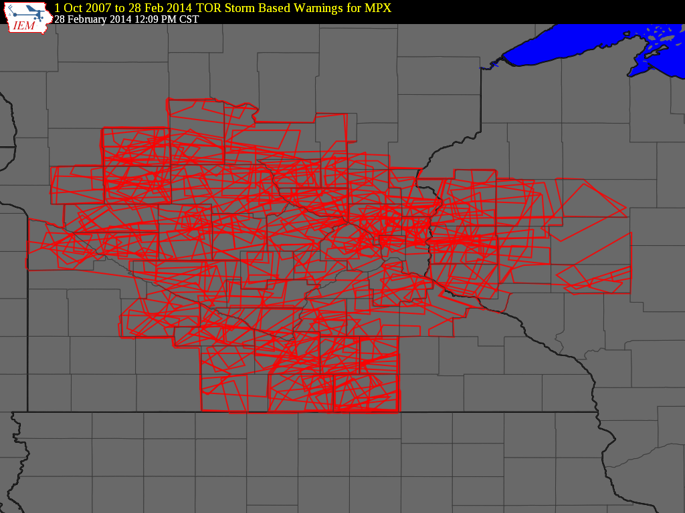

Slide 40
1 Oct 2007 – 28 Feb 2014: Number of Polygon Vertices (SVR+TOR)
56.5%
8.7%

Slide 41
Lets get quantitative
Perimeter Influence
How much of the polygon perimeter coincides with a political boundary
Size Reduction
How much smaller was the warning than the counties it was issued against.

Slide 42
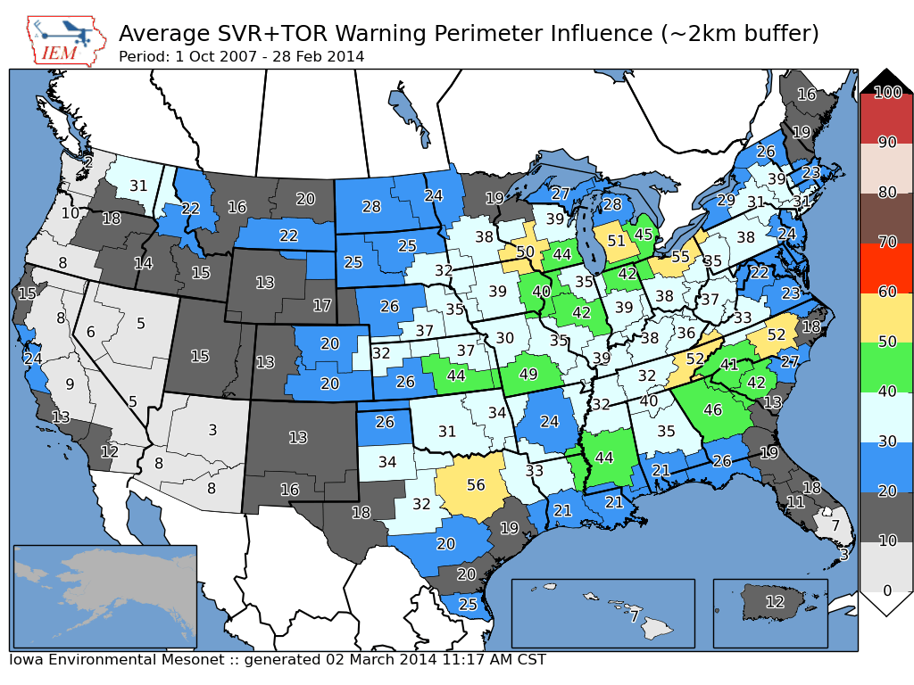

Slide 43
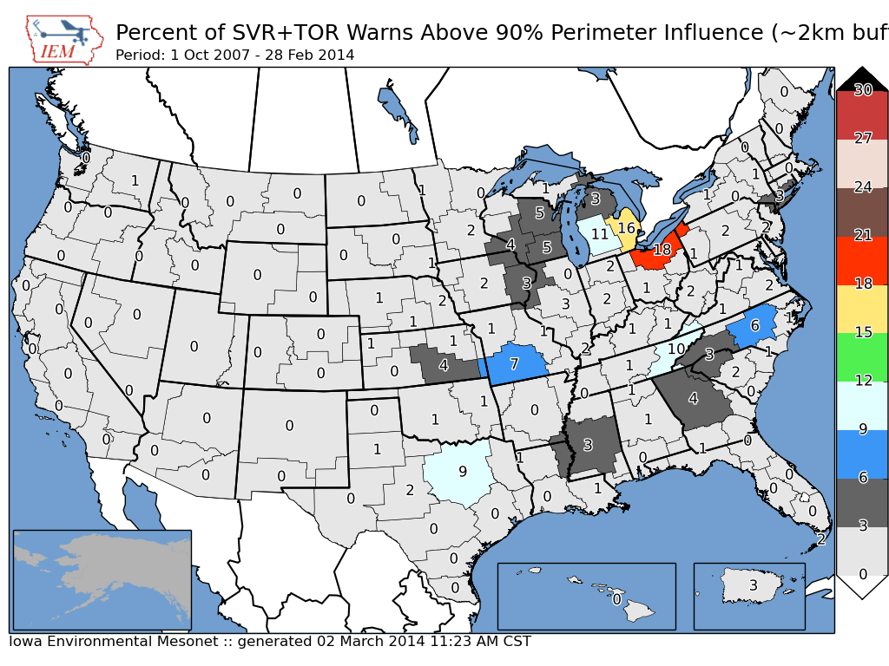
~ 2 % of all warnings

Slide 44
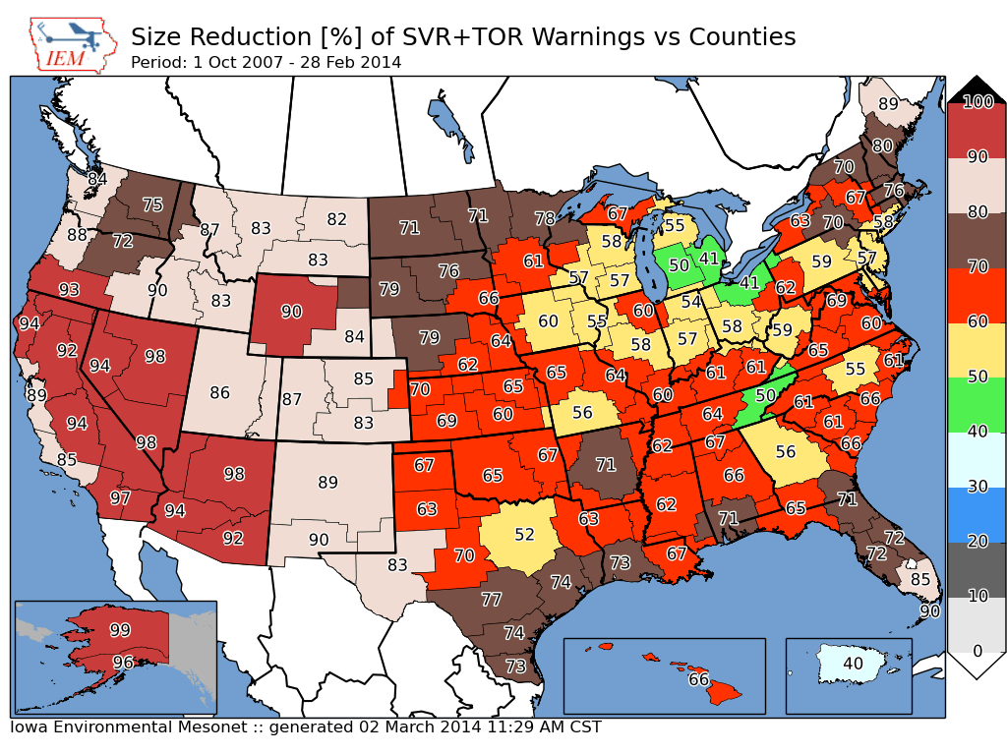
Nationwide Average: 65%

Slide 45
Storm Based Warning size reduction by number of counties in warning

Slide 46
Storm Based Warning # of Counties
0.7% of total

Slide 47
Oh daryl, what about this?
Perimeter ratio is small
So lets compute another metric measuring distance of vertex to county border
County
Warning

Slide 48
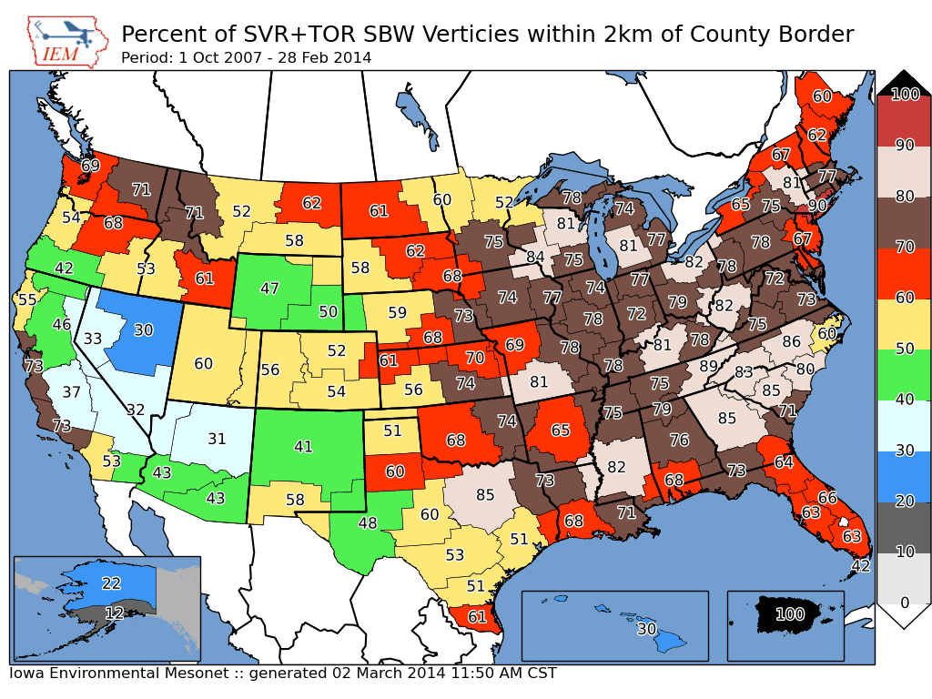
Overall Average: 75%
Overall: 75%

Slide 49
Academic Thought Experiment
Take TIME..MOT.LOC and draw my own warning:
30 min duration
~10 km left
~10 and increase to 30 km to the right
Which will #win ?

Slide 50
Purple box is the warning from
the automated algorithm

Slide 51
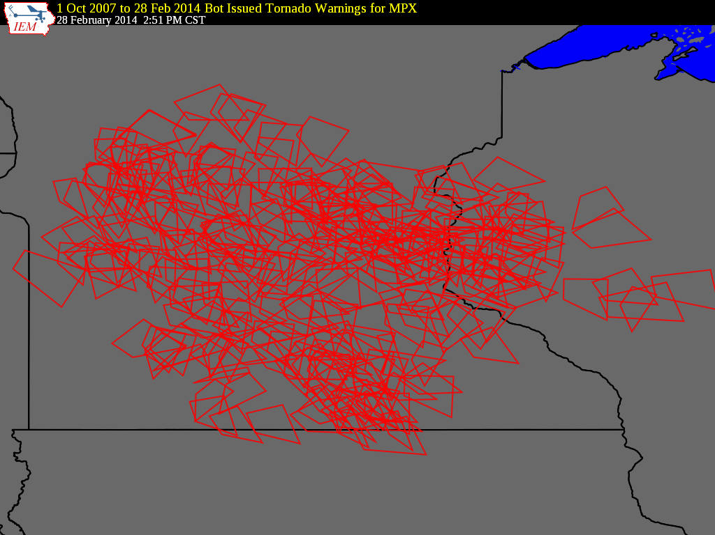

Slide 52
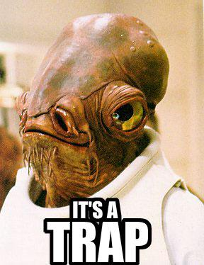
MPX’s TORs 2008-2013
 | WEATHER BUREAU | ACADEMIA
Average Size (sq km) | 1003 | 778
Areal Verification | 13% | 13.3%
Vertex County Intersection | 64.8% | 17.8%
Size Reduction | 73.2% | Didn’t Compute
Perimeter Ratio | 30% | 34%
Probability of Detection | 0.64 | 0.57
False Alarm Rate | 0.73 | 0.76
Critical Success Index | 0.23 | 0.21
Did the weather
bureau #win?

Slide 53
Chapter 2 Summary
~ 25% of TOR/SVR Warnings are 4 sided
Only ~ 2 % of all SVR/TOR warnings are pure county retracements
~ 75% of polygon vertices are guided by county borders
SBWs have cut the size of warnings by over 60%, but the number of county based warnings has increased.
The Cubs will not win the World Series this year

Slide 54
Apps & Archives
Chapter 3

Slide 56
COOP Reports by WFO
Realtime processing of SHEF data
Sortable columns
SWE reports are included
Snow/Precip ratio is computed for QC help
Click on NWSLI to get all reports for the year
(Discuss DCP vs COOP)

Slide 57
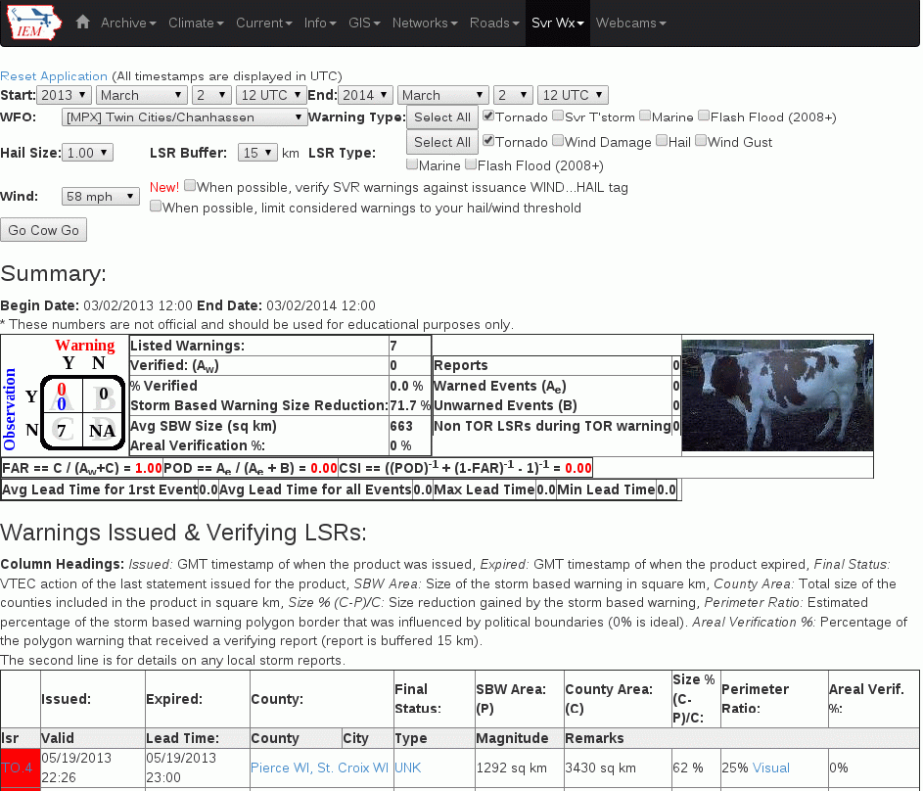
IEM Cow
SBW Verification based on Local Storm Reports, not Storm Data
Provides geometry stats on polygon
Handy way to review event data
It is ‘live’ and accurate at the time of page load

Slide 58
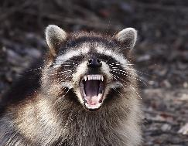
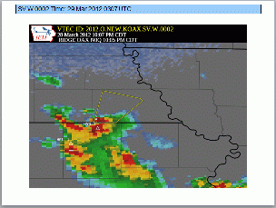
IEM Raccoon
OAX’s Dan Nietfeld gave me the idea
Create simple and quick Powerpoints of SVR,TOR warning events
Intended use:
Internal Office review of events
Quick materials for presentations

Slide 59
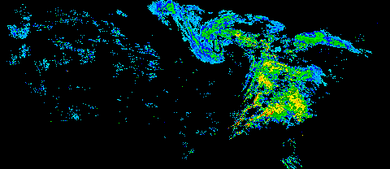
NEXRAD Archives
1km composite every 5 minutes back to 1995
Single site imagery since 1 Jan 2012
Iowa NEXRADs are backfilled.
MPX recently backfilled as well!
GIS Ready!

Slide 61
NEXRAD Storm Attribute Archive

Slide 62
Other Archives of Interest
App to quickly view text products by center by date or range of dates
Processed SHEF archive back to 2010
Shapefile download of VTEC warnings and Local Storm Reports
Nearly complete archive of ASOS/AWOS processed data and raw METARs
Processed MOS archive since 2007
Search VTEC Archive by Zone or by Point
Archived NWS WWA Map since 9 Apr 2013

Slide 63
Time for Questions?
mesonet.agron.iastate.edu
Daryl Herzmann
515.294.5978
akrherz@iastate.edu

