Slide 1

IEM Dog & Pony Show
Daryl Herzmann
@akrherz
Iowa State University
Notes:
Here we go!

Slide 2

What’s a Dog and Pony Show?
Wikipedia - "Dog and pony show" is a colloquial term which has come to mean a highly promoted, often over-staged performance, presentation, or event designed to sway or convince opinion for political, or less often, commercial ends.
Photo: Blogspot.com
Notes:
Lots of show upcoming, buckle up.

Slide 3
My Unabridged History
1978-1997 Grew up on dairy farm in NE Iowa frustrated by weather forecast for 3 days of dry weather when we’d mow hay only to have it rain.
2001 Got a BS in Meteorology from ISU, went home for a week to chop wood, came back to run the IEM.
2005-2017 Moonlighted on various NWS tasks including NWSChat, sigh.
2002-2020 Presented IEM stuff at ~20 NWS Offices. Your office could be next!

Slide 4
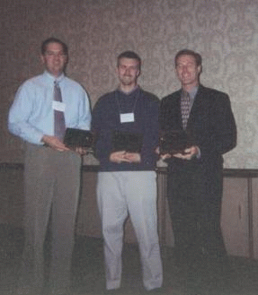
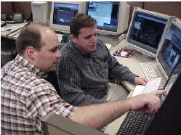
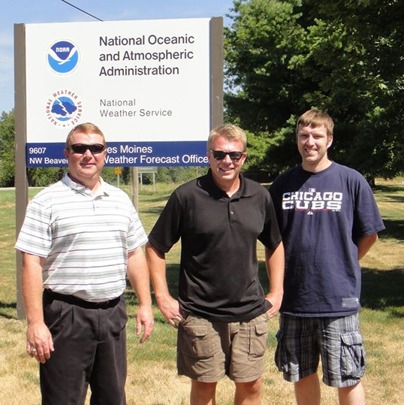
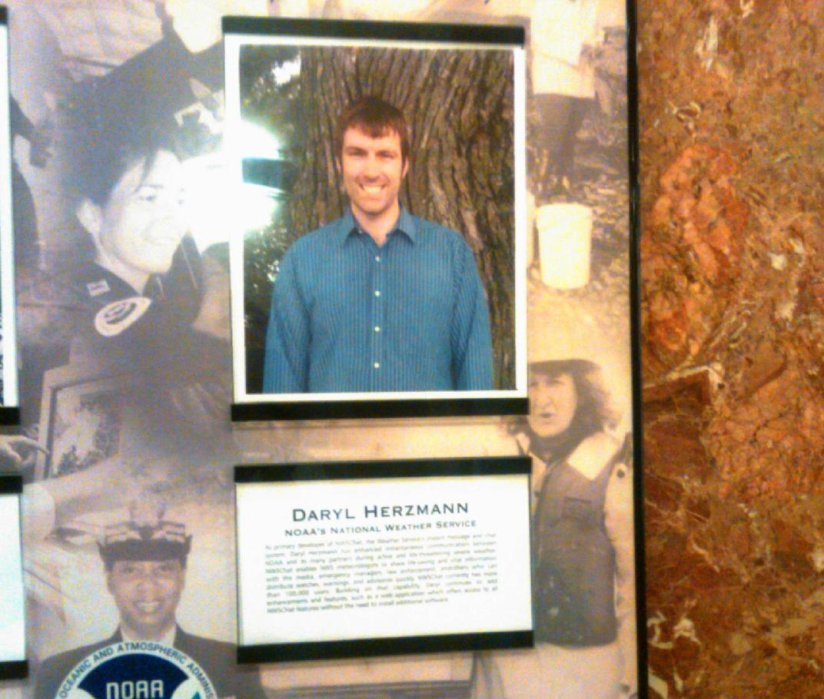
Precious Memories…

Slide 5
Talking Points Memo
Naming things is hard
  About the “Iowa” in my website’s name.
Web resources should have stable URIs!
Email says: “Please implement X”, me: “Sure”.
The IEM Website ranks second worst organized weather website.
So I am here, attempting to make sense of the chaos on the website, and shamelessly self promoting tools that should make your life easier.

Slide 6
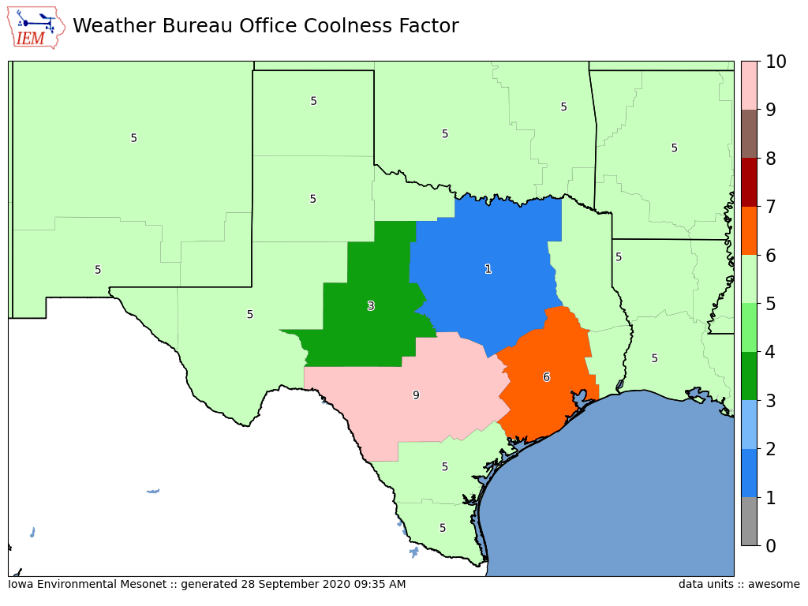
Firstly, about my WFO maps.
Purpose is not to show good/bad offices, but show gradients.

Slide 7
Websites of interest: https://mesonet.agron.iastate.edu https://mtarchive.geol.iastate.edu
~ 300 TB of “live” data on scrapable trees
~ 10 TB of database information fronted by various web services
~ 200 million web requests per day from about 250,000 unique IPs (Link)
~ 30 servers over 3 datacenters.
Ufffff, what a mess I have created!

Slide 8
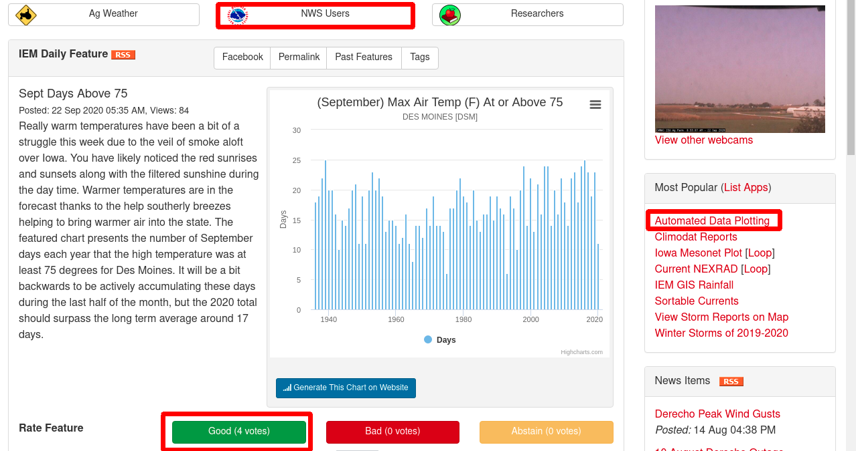
The IEM Website in its text-heavy glory.

Slide 9
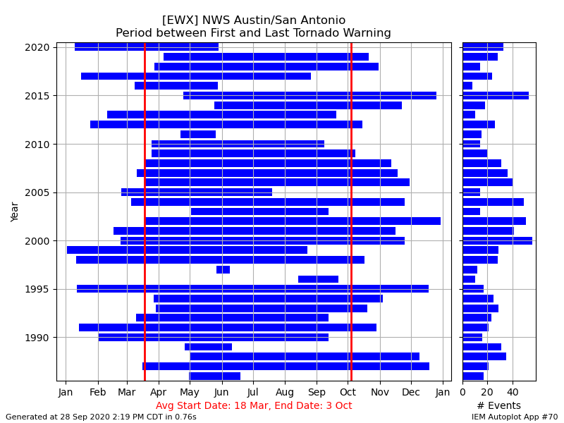
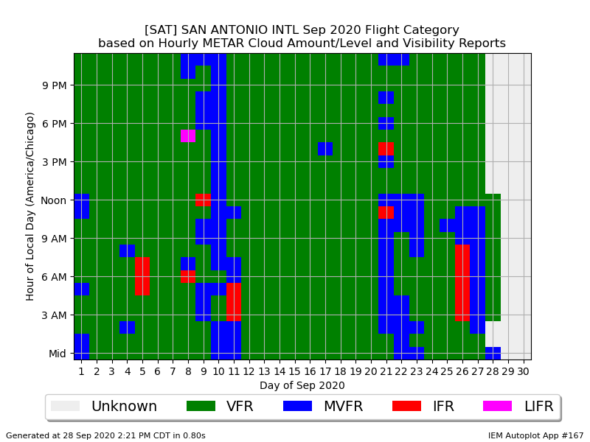
“Autoplot” application
~210 Plot Types
Pick color ramp, raw data export, stable URIs
Autoplot #70 (Link)
Autoplot #167 (Link)
Look in lower right corner for autoplot number!

Slide 10
Datasets Curated
(or how many abbreviations fit on one slide)
ASOS 1 Minute Data
Bufkit Profiles
CLI Data
Flash Flood Guidance
Global METAR
HML (River Stage Forecasts)
Iowa+ Webcams
Local Storm Reports
MADIS / “HFMETAR”
MRMS
NCEP F000 Models
NEXRAD Level II Live Data
NLDN (Not Public)
NRCS SCAN
NWS Text Archive
NWS “WaWA” Map
PIREPs
Public RWIS Networks
RADAR Products
RTMA
SHEF HADS/DCP/COOP
SIGMETs
SPC MCD/Watches/Outlooks
SMOS Satellite (Midwest)
Soundings
Text MOS
USCRN
Various Iowa-Only Observations
VTEC WaWA
15minute Fisher/Porter
Let us discuss more those highlighted in yellow.

Slide 11
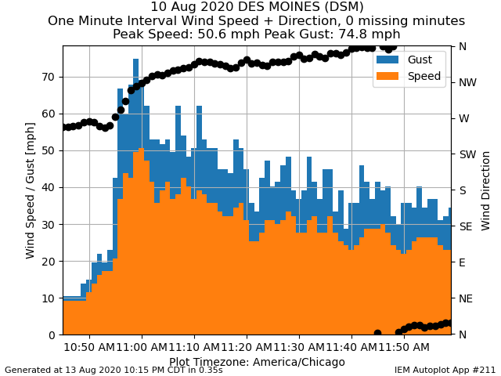
ASOS 1 Minute via NCEI
Daily processing what NCEI provides for 1 minute ASOS data
Archive back to 2000.
12-48 hour unavoidable delay for availability
Download Link
Autplot 211

Slide 12
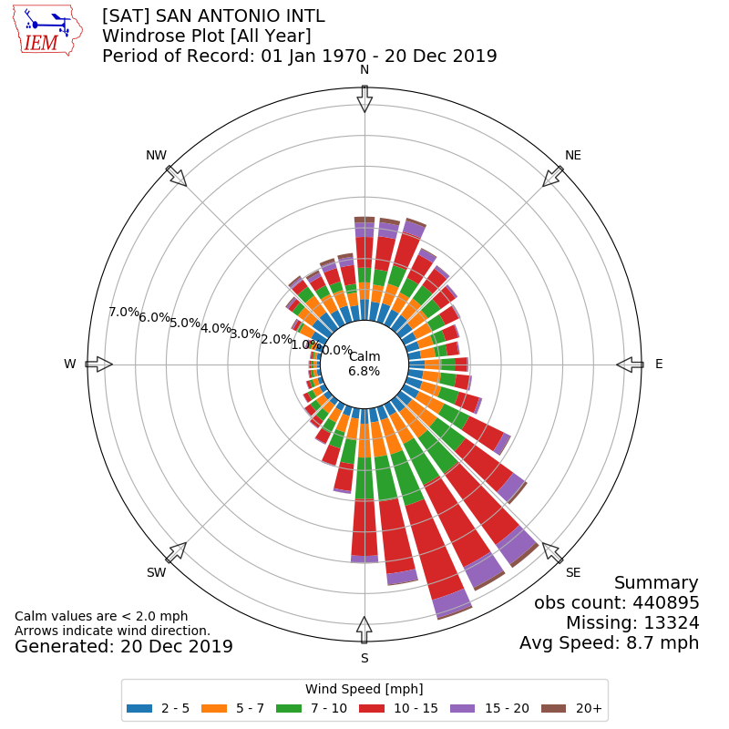
ASOS/METAR Archive
Lots of Global METAR data (billions of obs)
Lots of apps to summarize it
Merges MADIS “HFMETAR” data too
Windrose Link
Download Link

Slide 13
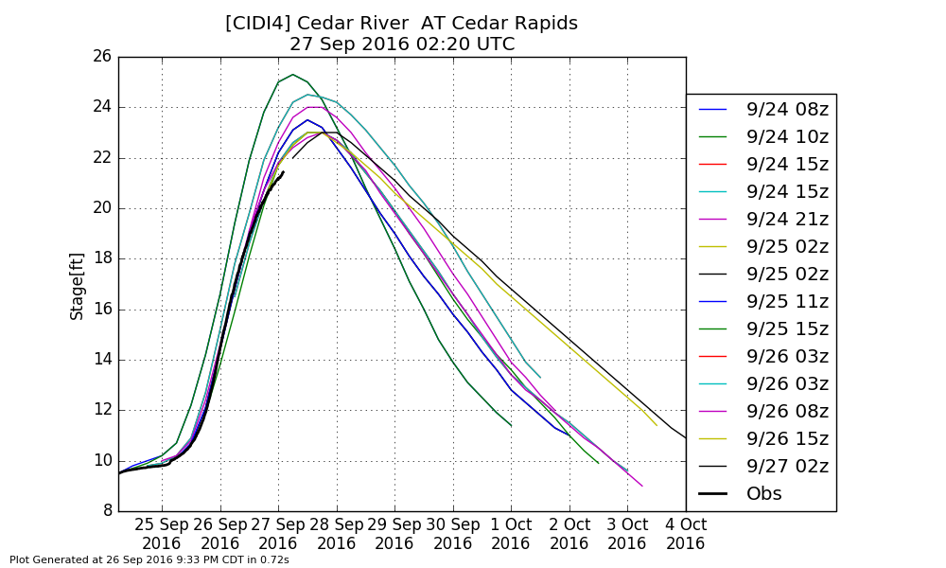
HML Obs/Forecast Archive (Link)
Archive all of the stage observations and forecast found in the HML product
Autoplot 160 can plot these and offers a spreadsheet download

Slide 14
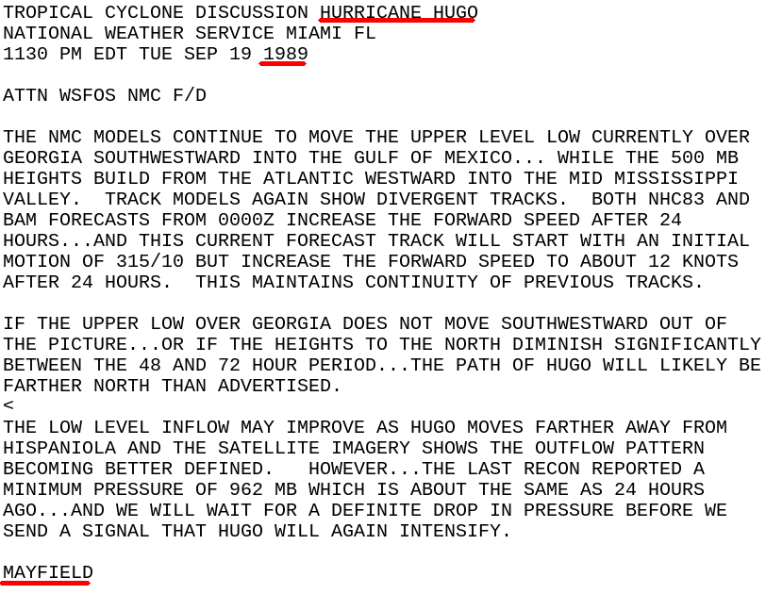
NWS Text Products back to 1983!
My most satisfying data to make public!
Gold mine!!!
Old WMO sources, centers, WSOs are stored using present day WFOs, etc.
Hit me up for custom queries, like finding forecaster’s first signed product.
(Link)

Slide 15
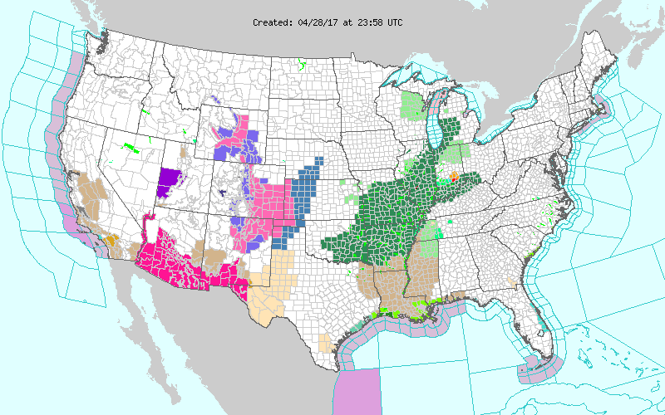
Archive of the weather.gov “WaWA” map since 2013 every 5 minutes (Link)

Slide 16
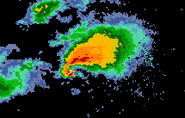
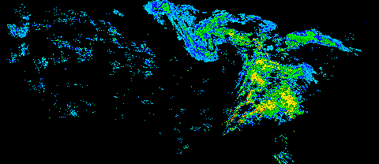
NEXRAD Archives
1km composite every 5 minutes back to 1995
Single site imagery since 1 Jan 2012
Iowa NEXRADs and few others are backfilled to mid 1990s
GIS Ready!

Slide 17
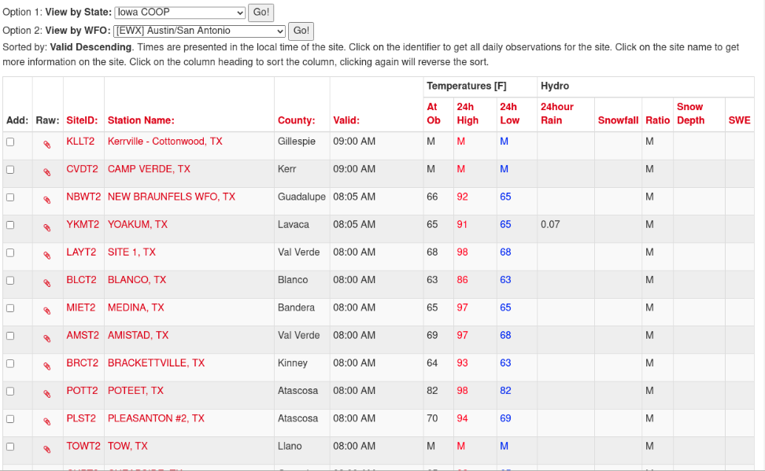
COOP Reports by WFO (Link)
Realtime processing of SHEF data
Sortable columns
SWE reports are included
Snow/Precip ratio is computed for QC help
Click on NWSLI to get all reports for the year
(Discuss DCP vs COOP)

Slide 18
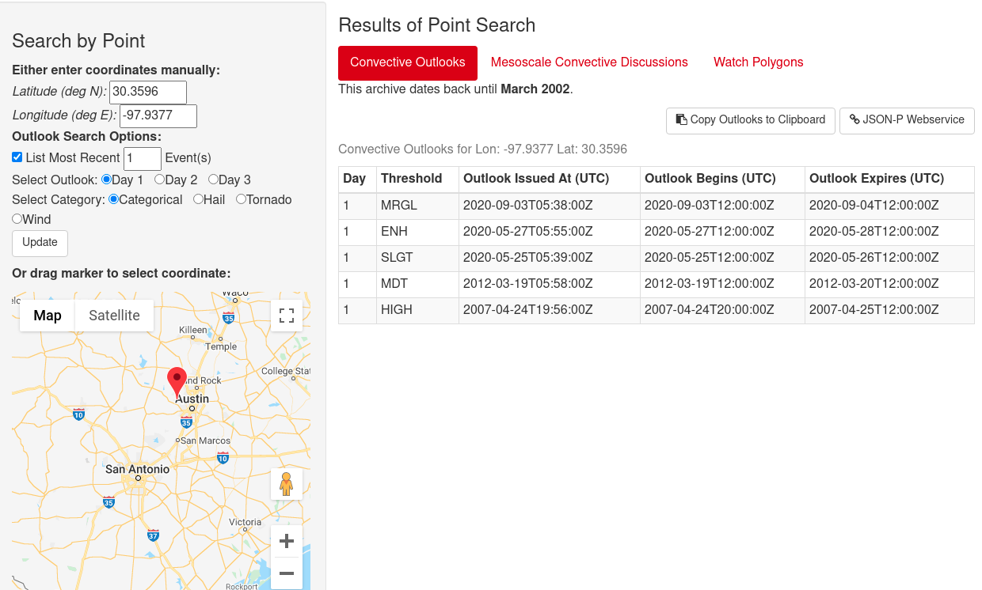
SPC Outlook / MCD / Watch Search by Point (Link)

Slide 19
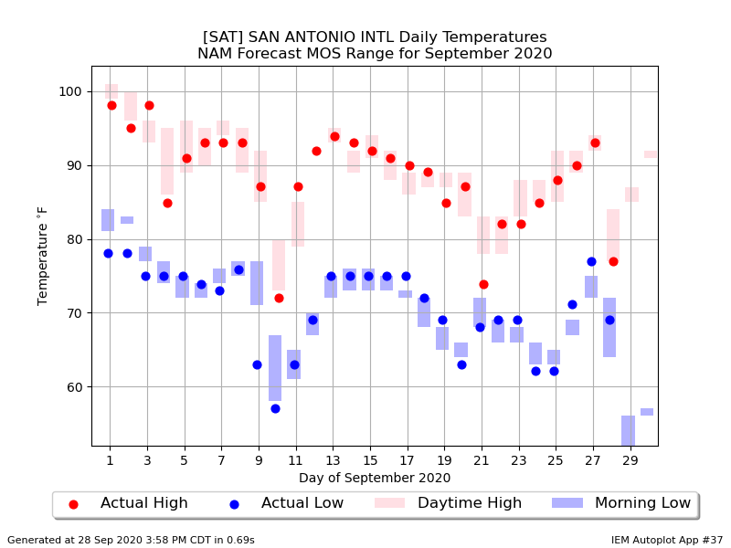
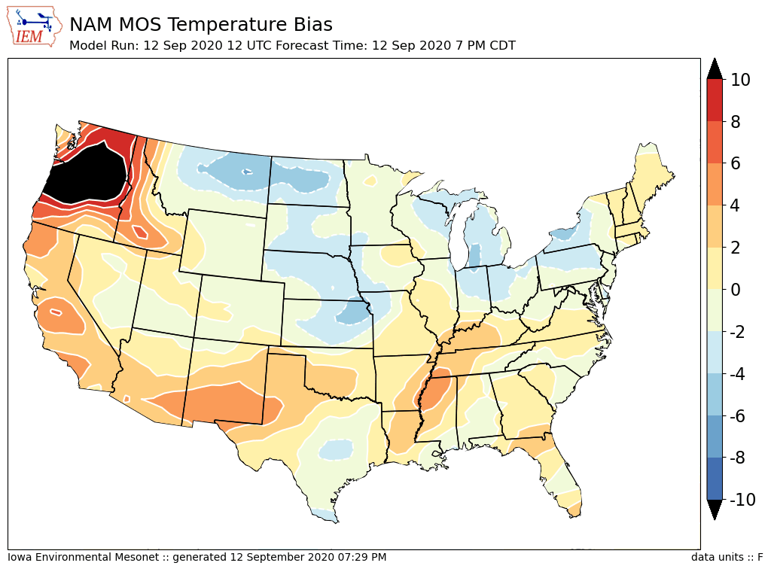
Archive Point/Text MOS
- Can download spreadsheets of data
“Autoplot 37” (Link)
Link

Slide 20
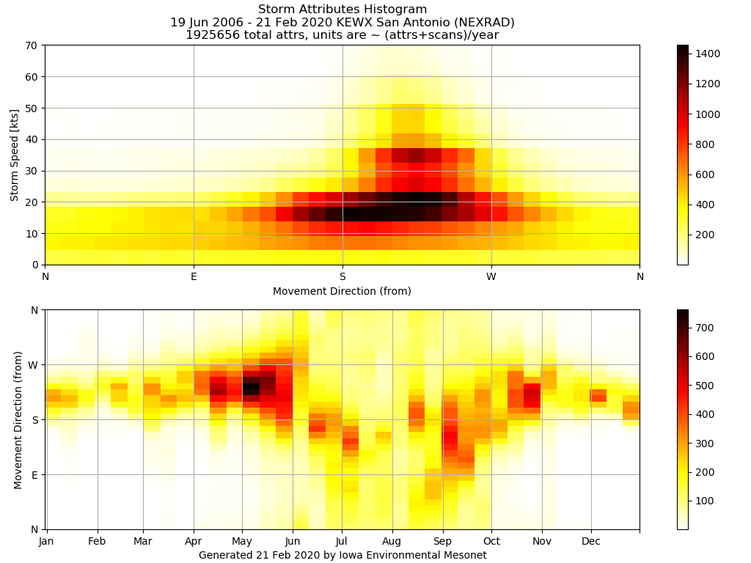
NEXRAD Storm Attribute Archive (Link)

Slide 21
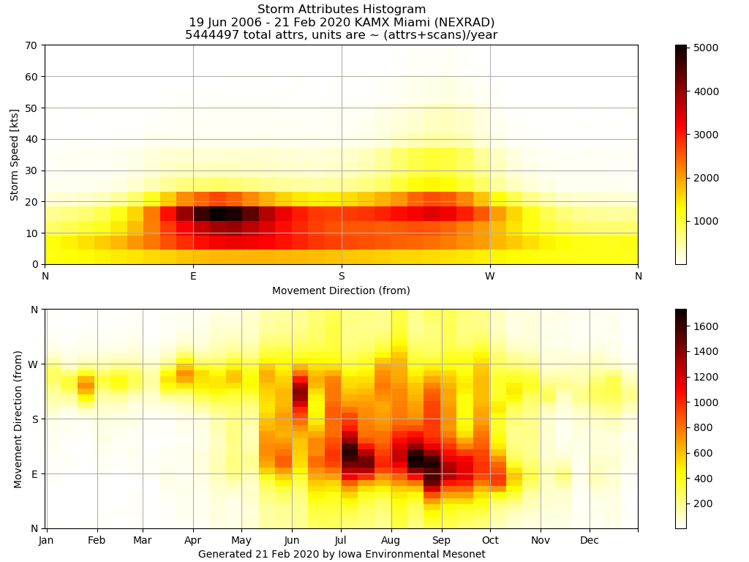
For comparison, here is Miami

Slide 22
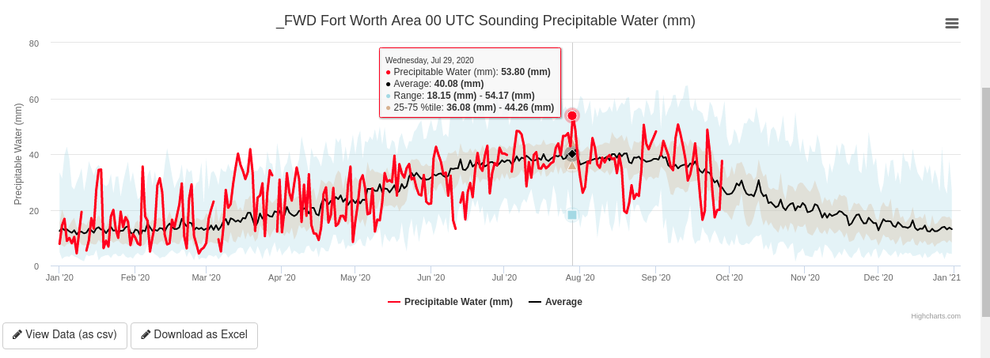
Sounding Archive
Yearly interactive timeseries, excel export (Link)
Computed ~40 some sounding parameters
This is a work in progress yet

Slide 23
The IEM’s VTEC Database
For various crazy reasons, perhaps the best (read: only public) NWS VTEC database exists in a corn field in the middle of Iowa with me.
323 Defect Reports since Aug 2017 (since I started keeping track of my whining!). Anyway, NWS HQ contacts say I am about the only one that complains anymore, gasp.
NWS Performance Branch database is smaller ☺
I created VTEC events for SVR, TOR, FFWs prior to 2008, may seek funding to expand that work.

Slide 24
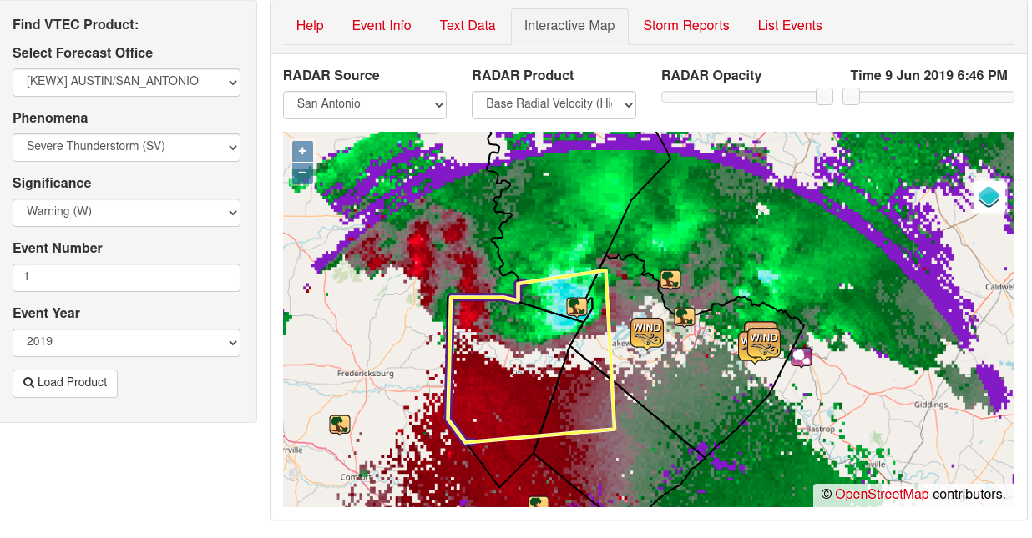
VTEC Browser (Link)

Slide 25
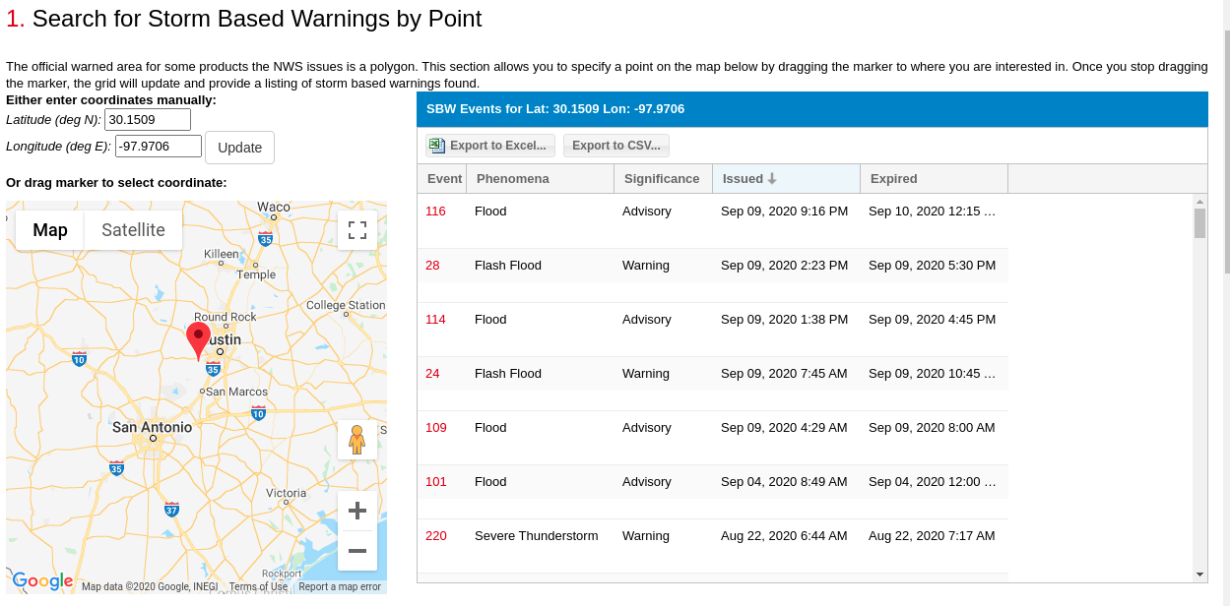
SBW Polygon Search by Point (Link)
(same page has by county/zone)

Slide 26
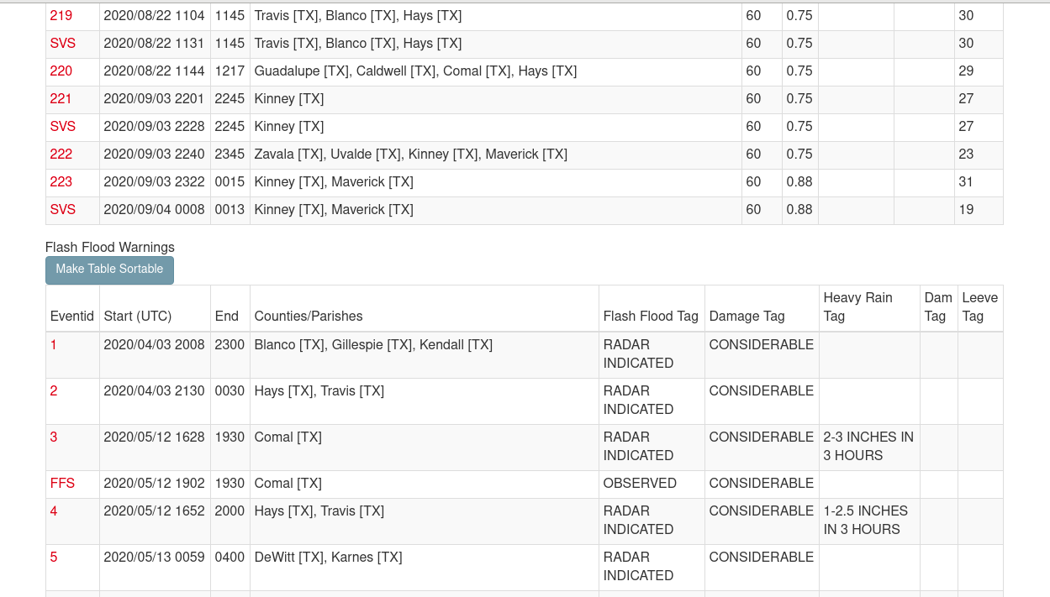
List Warning IBW Tags (Link)

Slide 27
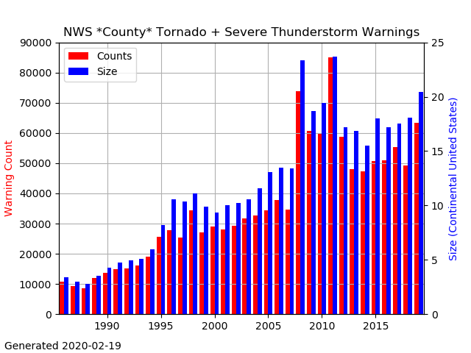
NWS County SVR/TOR Warnings
Storm Based Warnings
NEXRAD

Slide 28
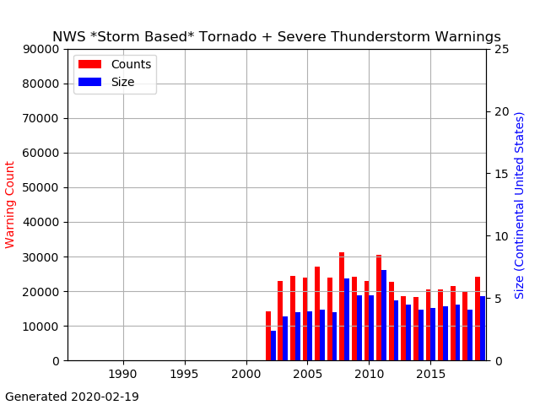
NWS SBW SVR/TOR Warnings

Slide 29
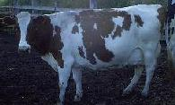
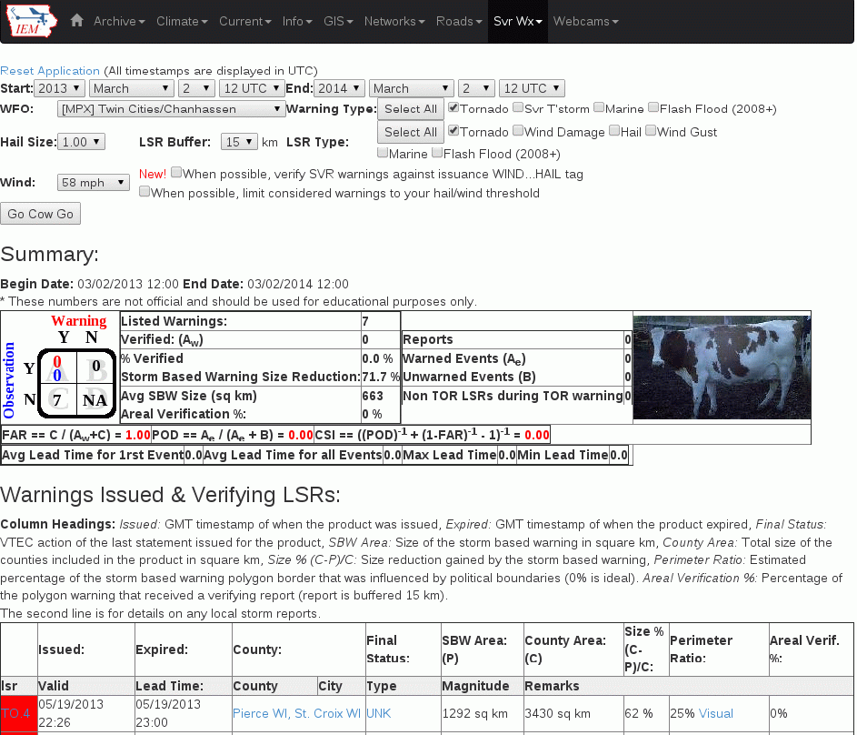
IEM Cow (Link)
SBW Verification based on Local Storm Reports, not Storm Data
Provides geometry stats on polygon
Handy way to review event data
It is ‘live’ and accurate at the time of page load

Slide 30

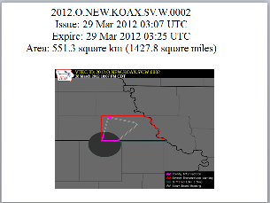
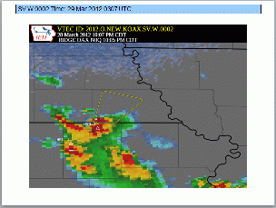
IEM Raccoon (Link)
OAX’s Dan Nietfeld gave me the idea
Create simple and quick Powerpoints of SVR,TOR warning events
Intended use:
  Internal Office review of events
  Quick materials for presentations

Slide 31
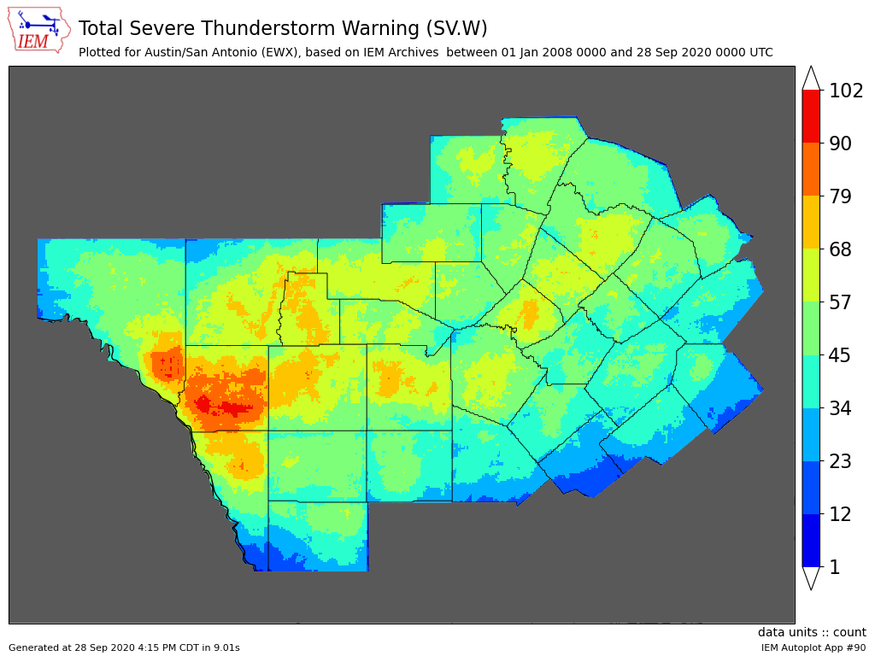
Autoplot #90 (Link)

Slide 32
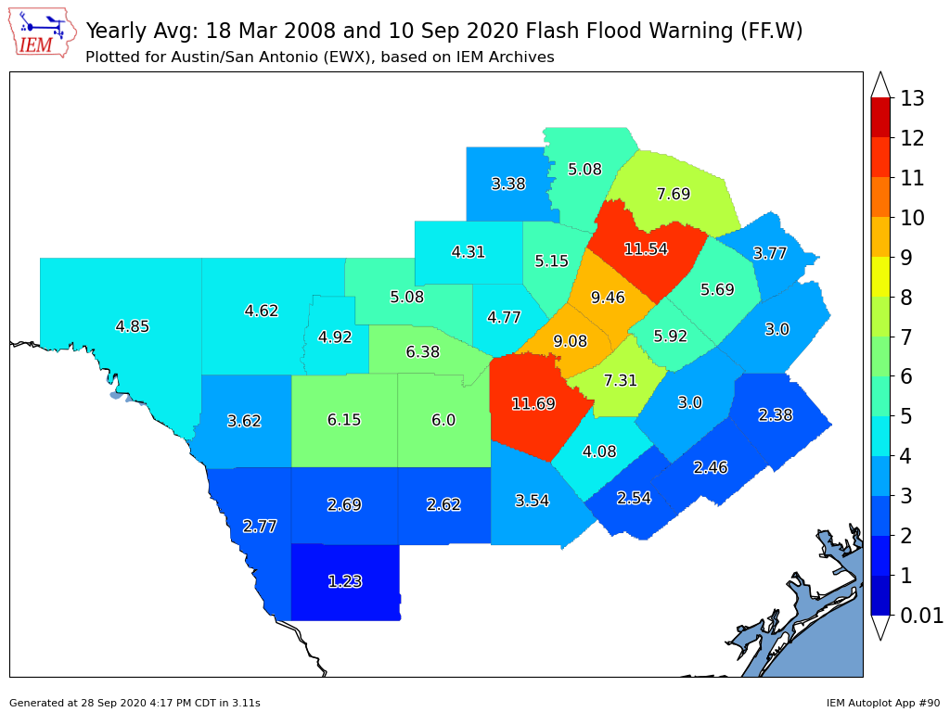
Autoplot #90 (Link)

Slide 33
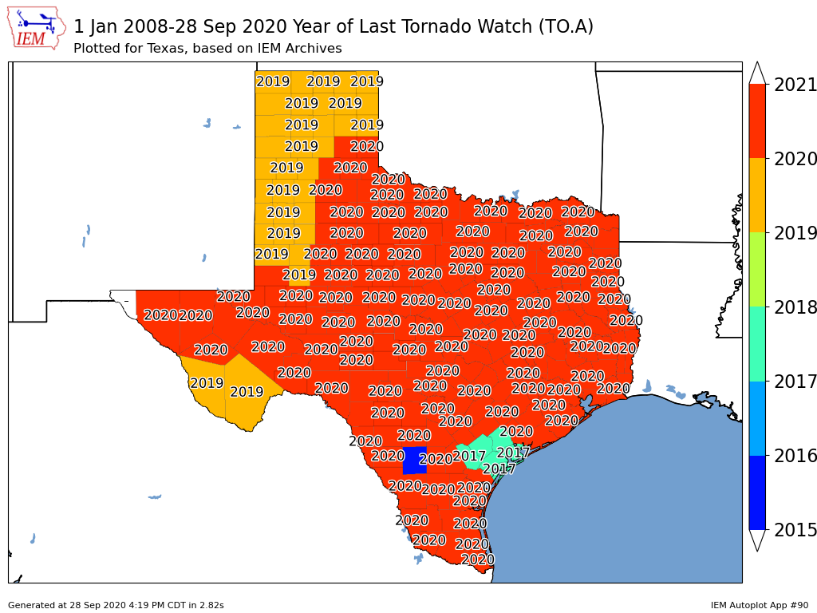
Autoplot #90 (Link)

Slide 34
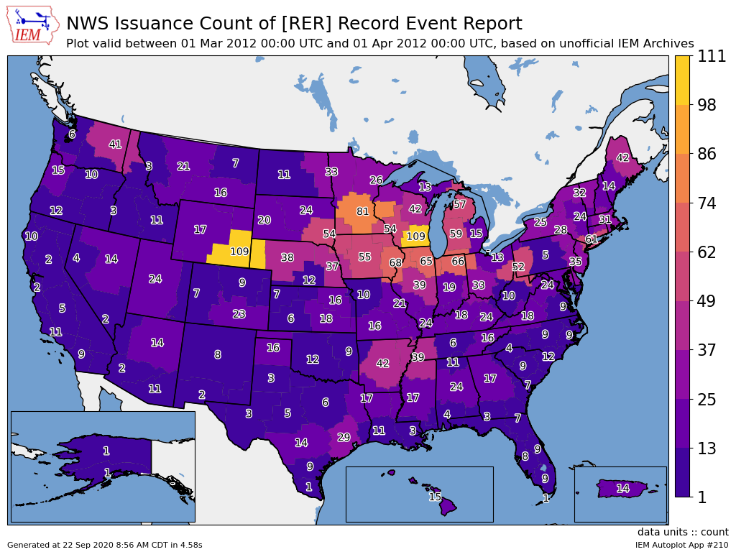
Autoplot #210 (Link)

Slide 35
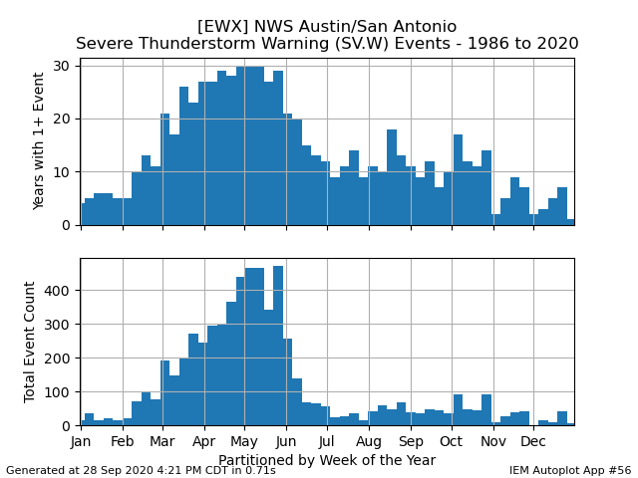
Autoplot #56 (Link)

Slide 36
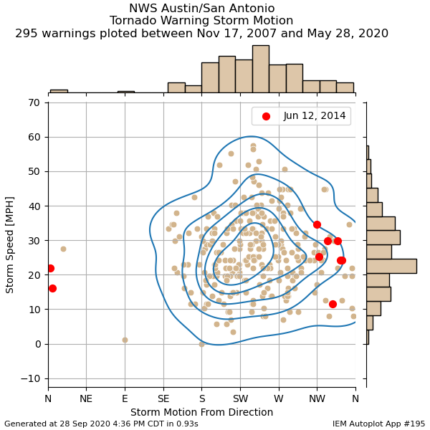
Autoplot #195 (Link)

Slide 37
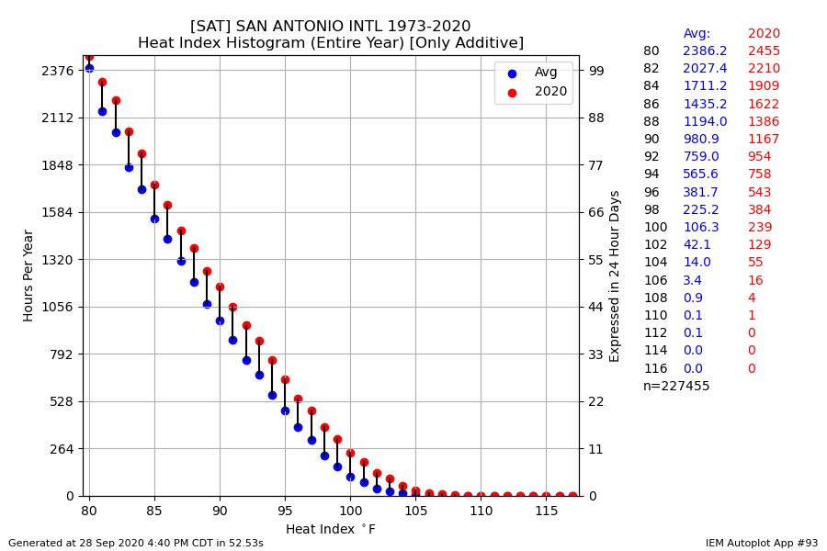
Autoplot #93 (Link)

Slide 38
My Standard Last Slide
Hopefully NCDC NCEI puts me out
of (my misery / business) someday!

Slide 39

Time for Questions?
PPT: IEM Website -> Info -> Presentations
mesonet.agron.iastate.edu
mtarchive.geol.iastate.edu
Daryl Herzmann
515.294.5978
akrherz@iastate.edu

