Slide 1
Using the IEM for Fun and/or Profit
Daryl Herzmann
@akrherz
Iowa State University
Notes:
Here we go!

Slide 2
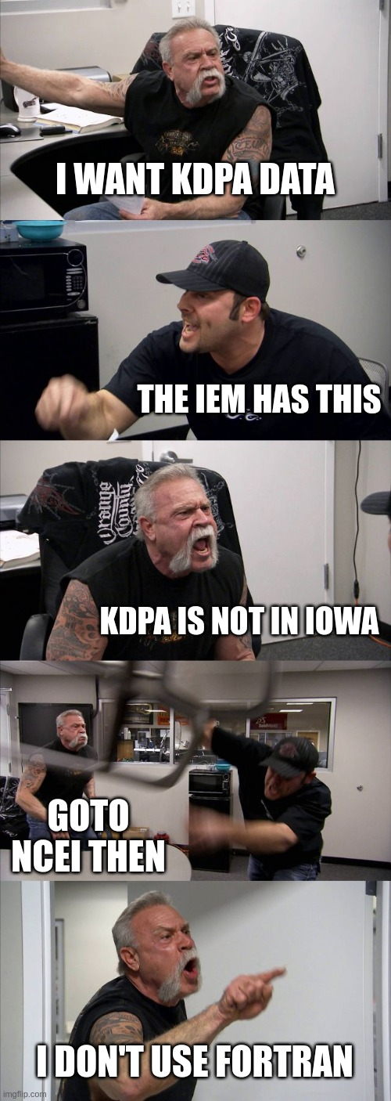
Iowa
Lots of data outside of Iowa
Environmental
Lots of data outside of temp/precip
Mesonet
More akin to “Mesowest”
No traditional “Mesonet” for Iowa, yet

Slide 3
What is going on here? https://mesonet.agron.iastate.edu
For past 22 years, I’ve implemented about 95% of the requests made of me for weather / climate products + data.
Unmitigated website feature sprawl with ~150 apps, ~30 download portals, and ~230 automated plotting apps.
To atone for these sins, I promptly answer all the emails I get. (GOTO step 1)

Slide 4
Subversive + Altruistic Goals
Create open and reproducible workflows
*Everything* on Github with permissive license
Do small things well, iterate rapidly
The advantage of being on island / thiefdom
Keep URLs stable, deep linkable, predictable
Bookmarks / links should live forever!
Enjoy the irony
I’m in the middle of an Iowa corn field creating services and datasets used all over the place.

Slide 5
Importance of (Git)hub
Learn tools of collaborative code development
A means of backup and reversion control
Take advantage of lots of free CI, AI, community tooling for software QA/QC
Watch over the shoulders of giants
Lurk on various important repositories
Git-ops, local development, push to production

Slide 6
Websites, on the Internets: https://mesonet.agron.iastate.edu https://mtarchive.geol.iastate.edu https://mesonet-nexrad.agron.iastate.edu https://mrms.agron.iastate.edu https://metfs1.agron.iastate.edu
~ 300 TB of “live” data on scrapable trees
~ 10 TB of database information fronted by various web services
~ 200 million web requests per day from about 250,000 unique IPs (Link)
~ 30 servers over 3 datacenters.
Ufffff, what a mess I have created!

Slide 7
The IEM Website in its text-heavy glory.

Slide 8
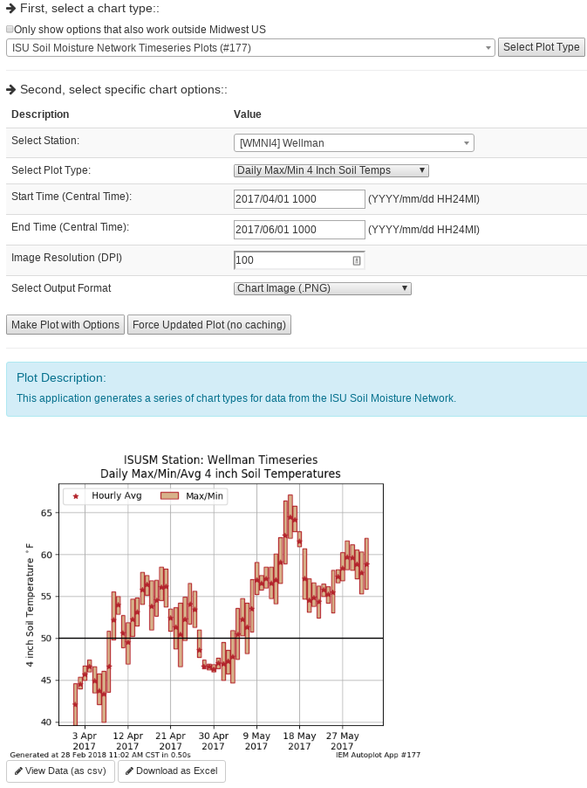
IEM Auto Plotting
Select Plot Type
Select Plot Options
Description
Custom Generated Plot
(Deep/Direct Embed]
Download Raw Data (Excel)

Slide 9
“Autoplot” application ~230 Plot Types Pick color ramp, raw data export, stable URIs
Autoplot #70 (Link)
Autoplot #167 (Link)
Look in lower right corner for autoplot number!

Slide 10
Datasets Curated (or how many abbreviations fit on one slide)
ASOS 1 Minute Data
Bufkit Profiles
CLI Data
Flash Flood Guidance
Global METAR
HML (River Stage Forecasts)
Iowa+ Webcams
Local Storm Reports
MADIS / “HFMETAR”
MRMS
NCEP F000 Models
NEXRAD Level II Live Data
NLDN (Not Public)
NRCS SCAN
NWS Text Archive
NWS “WaWA” Map
PIREPs
Public RWIS Networks
RADAR Products
RTMA
SHEF HADS/DCP/COOP
SIGMETs/CWAs
SPC MCD/Watches/Outlooks
SMOS Satellite (Midwest)
Soundings
Text MOS
USCRN
Various Iowa-Only Observations
VTEC WaWA
15minute Fisher/Porter
Let us discuss more those highlighted in yellow.

Slide 11
ASOS 1 Minute via NCEI
Daily processing what NCEI provides for 1 minute ASOS data
Archive back to 2000.
12-48 hour unavoidable delay for availability
Download Link
Autplot 211

Slide 12
ASOS/METAR Archive
Lots of Global METAR data (billions of obs)
Lots of apps to summarize it
Merges MADIS “HFMETAR” data too
Windrose Link
Download Link

Slide 13
MRMS/PRISM/Stage IV Maps
Windrose Link
Generate zoomed in maps of daily precip estimates
Generate departures over custom periods of time

Slide 14
HML Obs/Forecast Archive (Link)
Archive all of the stage observations and forecast found in the HML product
Autoplot 160 can plot these and offers a spreadsheet download

Slide 15
NWS Text Products back to 1983!
My most satisfying data to make public!
Gold mine!!!
Old WMO sources, centers, WSOs are stored using present day WFOs, etc.
Hit me up for custom queries, like finding forecaster’s first signed product.
(Link)

Slide 16
Archive of the weather.gov “WaWA” map since 2013 every 5 minutes (Link)

Slide 17
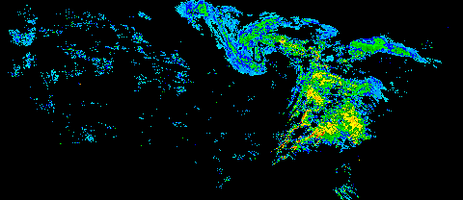
NEXRAD Archives
1km composite every 5 minutes back to 1995
Single site imagery since 1 Jan 2012
Iowa NEXRADs and few others are backfilled to mid 1990s
GIS Ready!

Slide 18
SPC Outlook / MCD / Watch Search by Point (Link)

Slide 19
Archive Point/Text MOS - Can download spreadsheets of data
“Autoplot 37” (Link)
Link

Slide 20
NEXRAD Storm Attribute Archive (Link)

Slide 21
For comparison, here is Miami

Slide 22
Sounding Archive
Yearly interactive timeseries, excel export (Link)
Computed ~40 some sounding parameters
SPC thankfully has something better than this.

Slide 23
The IEM’s VTEC Database
For various crazy reasons, perhaps the best (read: only public) NWS VTEC database exists in a corn field in the middle of Iowa with me.
887 Defect Reports since Aug 2017 (since I started keeping track of my whining!). Anyway, NWS HQ contacts say I am about the only one that complains anymore, gasp.
NWS Performance Branch database is smaller ☺
I created VTEC events for SVR, TOR, FFWs prior to 2005, may seek funding to expand that work.

Slide 24
VTEC Browser

Slide 25
SBW Polygon Search by Point (Link) (same page has by county/zone)

Slide 26
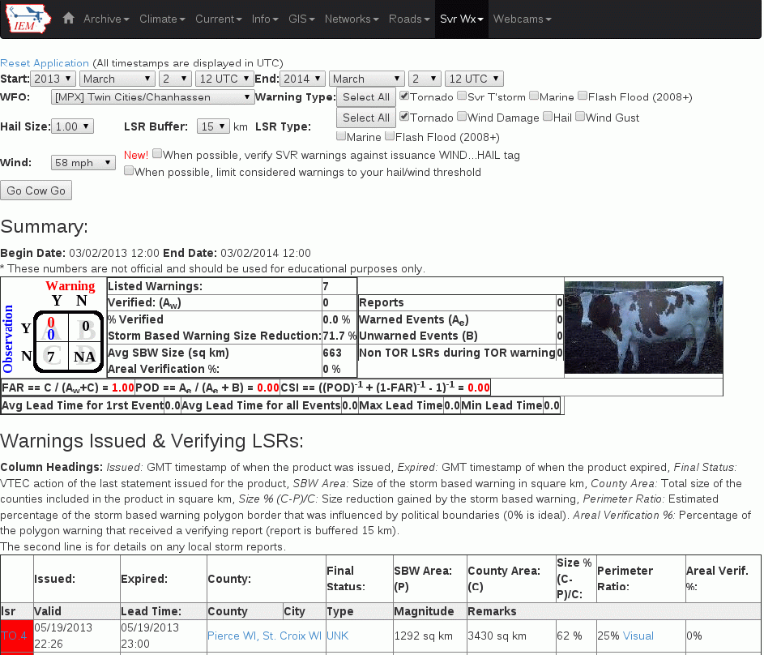
IEM Cow (Link)
SBW Verification based on Local Storm Reports, not Storm Data
Provides geometry stats on polygon
Handy way to review event data
It is ‘live’ and accurate at the time of page load

Slide 27
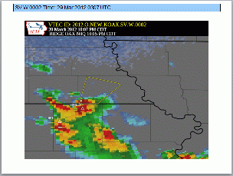
IEM Raccoon (Link)
Create simple and quick Powerpoints of SVR,TOR warning events
Intended use:
Internal Office review of events
Quick materials for presentations

Slide 28
Autoplot #90 (Link)

Slide 29
Autoplot #90 (Link)

Slide 30
Autoplot #90 (Link)

Slide 31
Autoplot #210 (Link)

Slide 32
Autoplot #56 (Link)

Slide 33
Autoplot #195 (Link)

Slide 34
My Standard Last Slide
Hopefully NCDC NCEI puts me out
of (my misery / business) someday!

Slide 35
Time for Questions? PPT: IEM Website -> Info -> Presentations
mesonet.agron.iastate.edu
mtarchive.geol.iastate.edu
Daryl Herzmann
515.294.5978
akrherz@iastate.edu

